Slide 1
HFA Atlas - 1st Edition
Slide Library
Heart Failure Association of the ESC
European Heart Health Institute
European Heart Agency
Version 15 June 2020

Slide 2
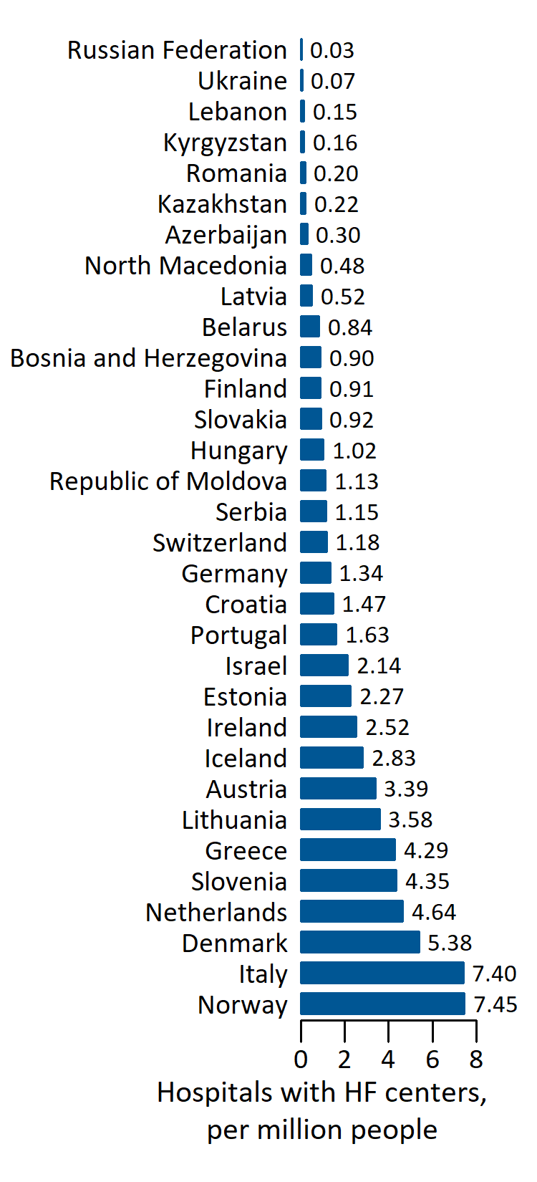
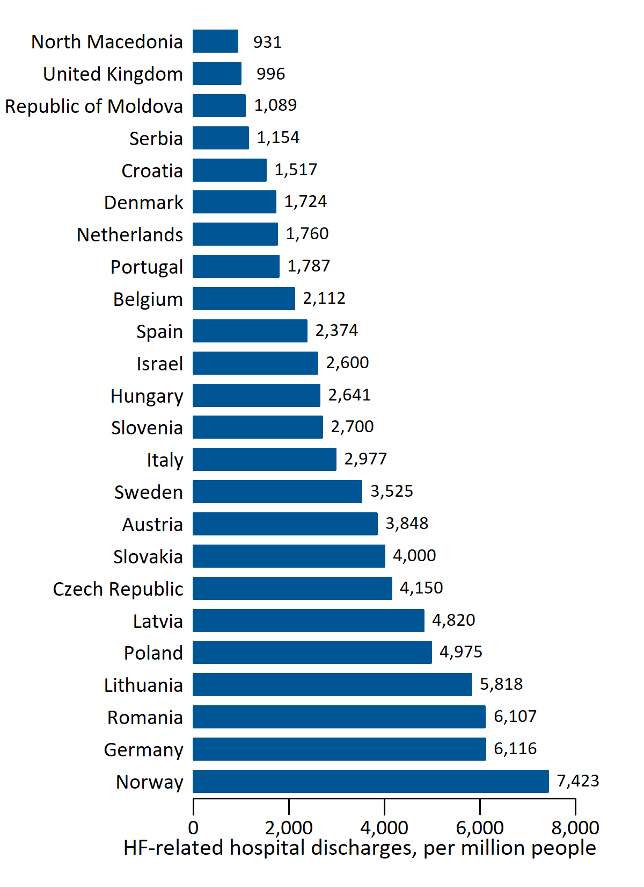
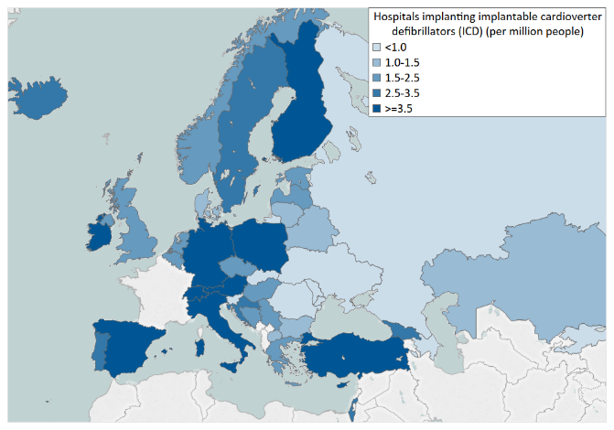
HFA Atlas – Four Main Sections
Demographics and Healthcare Systems
Heart Failure Epidemiology
Healthcare Resources with Focus on HF
Services and Interventions

Slide 3
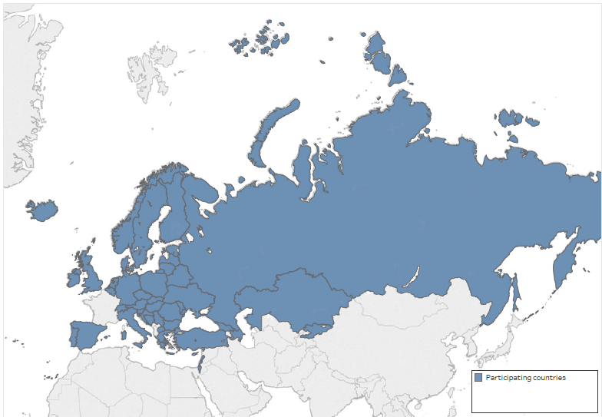
Forty-two (42) Participating Countries
Austria
Azerbaijan
Belarus
Belgium
Bosnia and Herzegovina
Bulgaria
Croatia
Cyprus
Czech Republic
Denmark
Estonia
Finland
Georgia
Germany
Greece
Hungary
Iceland
Ireland
Israel
Italy
Kazakhstan
Kyrgyzstan
Latvia
Lebanon
Lithuania
North Macedonia
Moldova
Netherlands
Norway
Poland
Portugal
Romania
Russian Federation
Serbia
Slovakia
Slovenia
Spain
Sweden
Switzerland
Turkey
Ukraine
UK

Slide 4
HFA Atlas -1stedition
•Heartfailure(HF)representsthegrowingcardiovascularburdenandthemajor
publichealthissueinthecontemporaryera.Nevertheless,comprehensivestatistics
onHFepidemiologyandrelatedmanagementinEuropearestillmissing.
•TofillinthisgapHeartFailureAssociationoftheESCinitiatedtheHFAAtlasproject.
•HFAAtlasisauniquecompendiumcontainingdataonHeartFailureepidemiology
andresourcescollectedfromtheNationalHeartFailureSocietiesandtheESCAtlasof
Cardiology.
•ThepurposeoftheHFAAtlasistoimprovethequalityoflifeandlongevitythrough:
•Betterprevention,diagnosisandtreatmentofheartfailure
•Establishmentofnetworksformanagement,educationandresearch

Slide 5
Data quality assurance
To guarantee the quality of the data, the HFA Atlas project followed the same very strict and
pre-defined structure of the work plan for the ESC Atlas of Cardiology which is described in
the following steps:
•HFA Atlas questionnaire: The questionnaire used to collect data was reviewed by internal
experts (HFA leaders), as well as the ESC Health Policy Unit team.
•HFA Atlas manual: To ensure consistency, a unique manual was defined based on
international definitions of all variables and specifically developed for HFA Atlas
(harmonised with the definitions used in the ESC Atlas of Cardiology). The HFA Atlas manual
was used across National Societies of Heart Failure contacted.

Slide 6
Data quality assurance
•Data cross-reference: Collected data is cross-checked with other data sets collected by ESC
Atlas of Cardiology, ESC Associations or available in the literature and other related
international sources.
•Statistical Validation: Data sets are rigorously processed, checked and validated by the
data processing team using appropriate software.
•Indicator benchmarking: Comparative indicators are used to identify unusual differences,
outliers or non-realistic data.

Slide 7
Deliverables
•HFA Atlas Slide Library: A ready to use collection of power-point slide sets based on
information contained in the benchmarking report, the comparative graphs, charts and
maps with the most interesting and important variables and indicators of HFA Atlas. This
slide deck is designed to be used for presentation purposes by various stakeholders to
benchmark countries with each other, to demonstrate trends, associations, statuses, and
variability across Europe
•eHFA-Atlas –dedicated website and visualisation tool: All data contained in the HFA Atlas
are presented in interactive maps and bar graphs via the interactive data visualization tool.
The user is able to choose the variables and make the associations of his choice, view and
download the graphics.

Slide 8
Bar Charts and Maps
•Demographics and Healthcare Systems
•Heart Failure Epidemiology
•Healthcare Resources with Focus on Heart Failure
•Services and Interventions

Slide 9
Demographics and Healthcare System

Slide 10
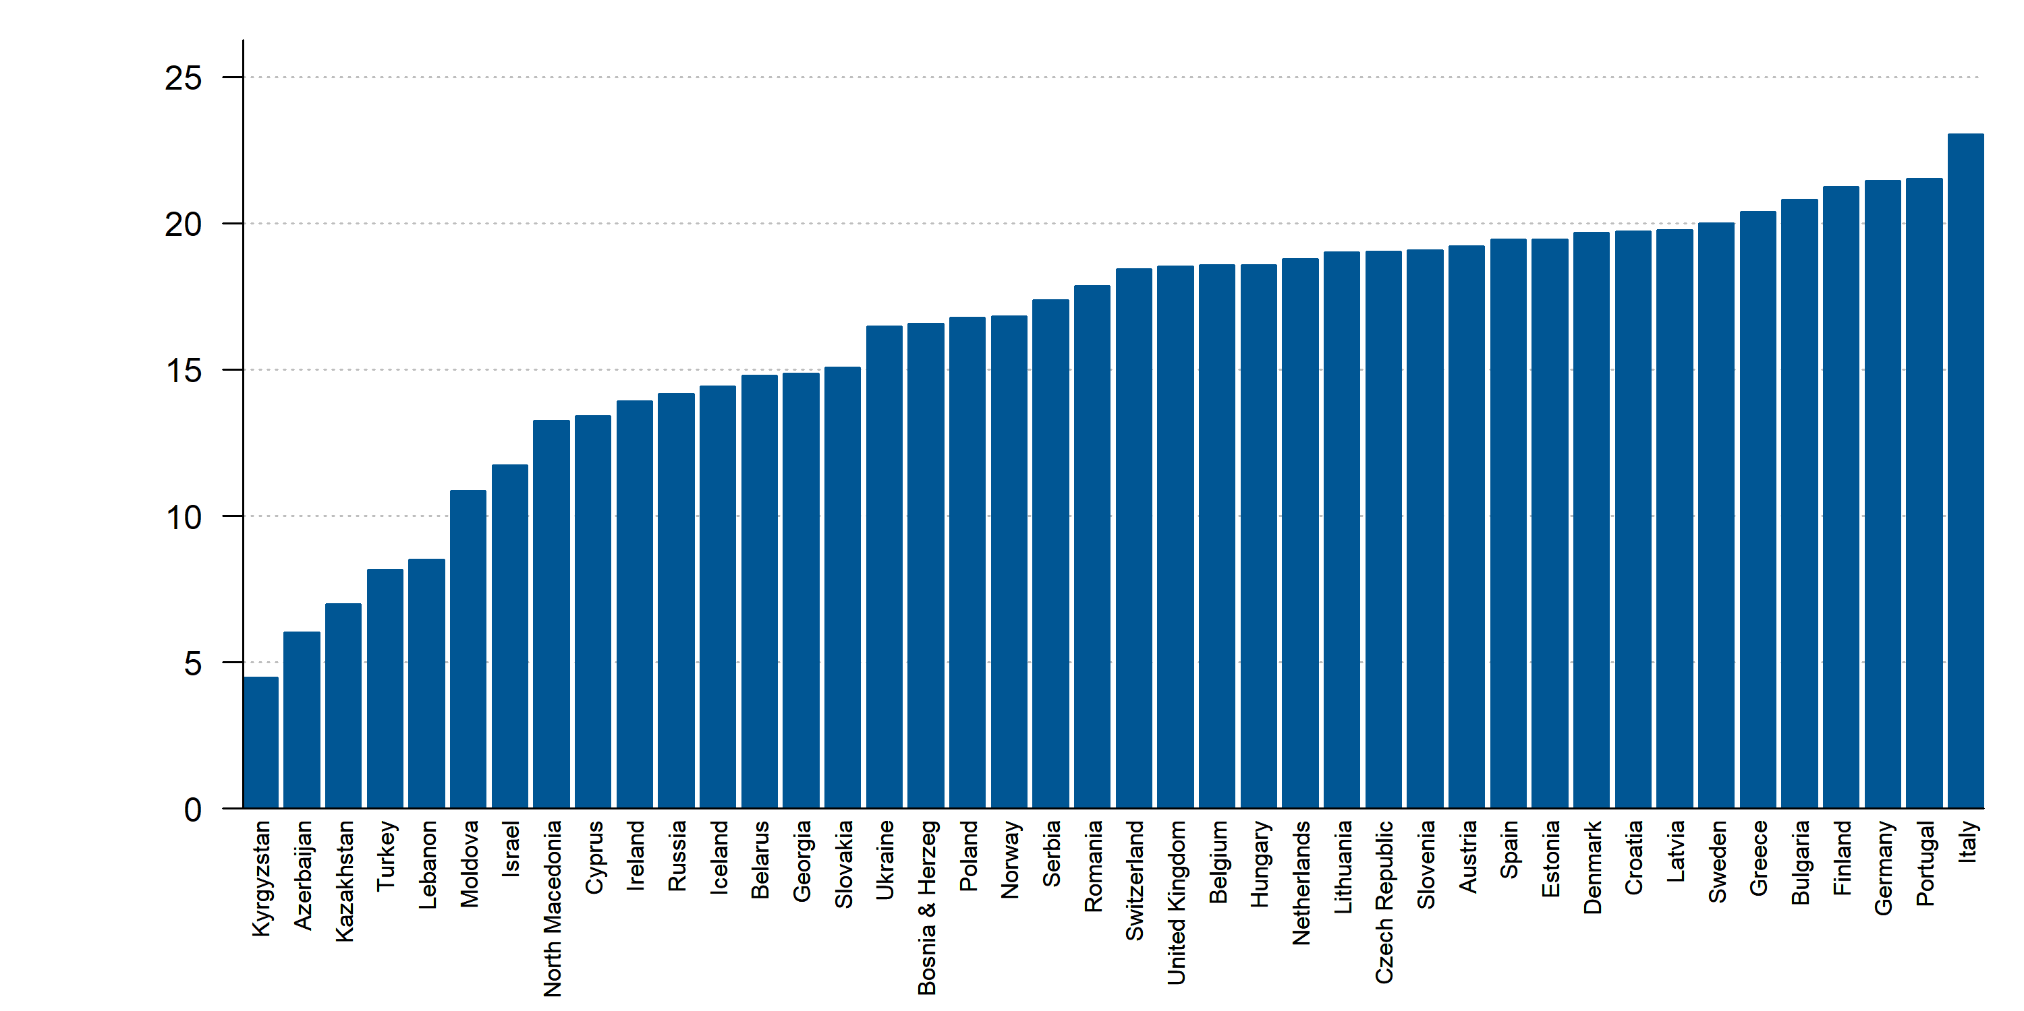
Population ages 65 and above (% of total population), 2017 or latest year
Source: World Bank.

Slide 11
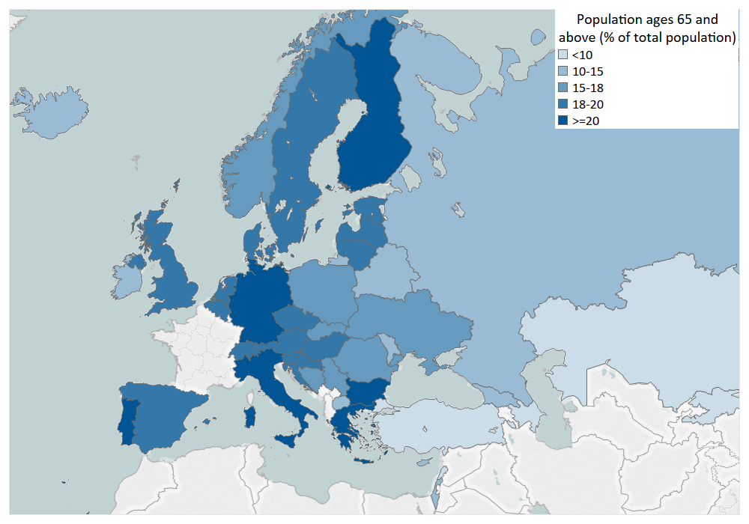
Population ages 65 and above (% of total population), 2017 or latest year
Source: World Bank.

Slide 12
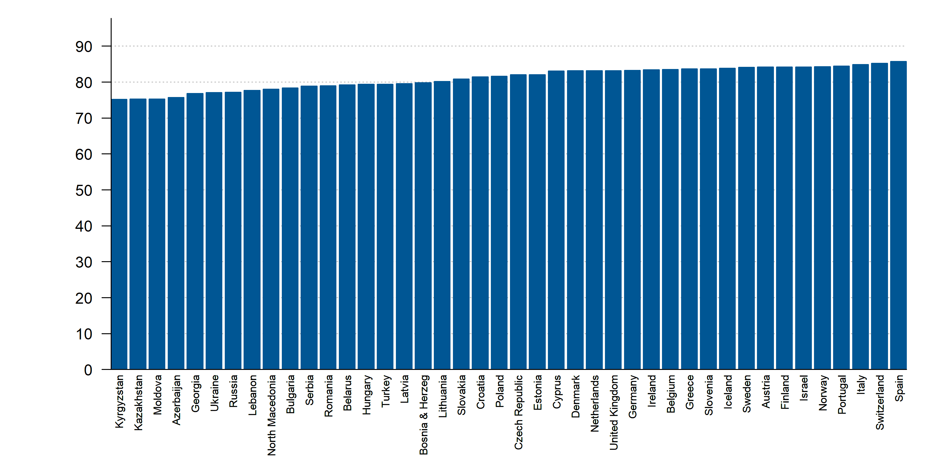
Life expectancy at birth, female (years), 2016 or latest year
Source: WHO.

Slide 13
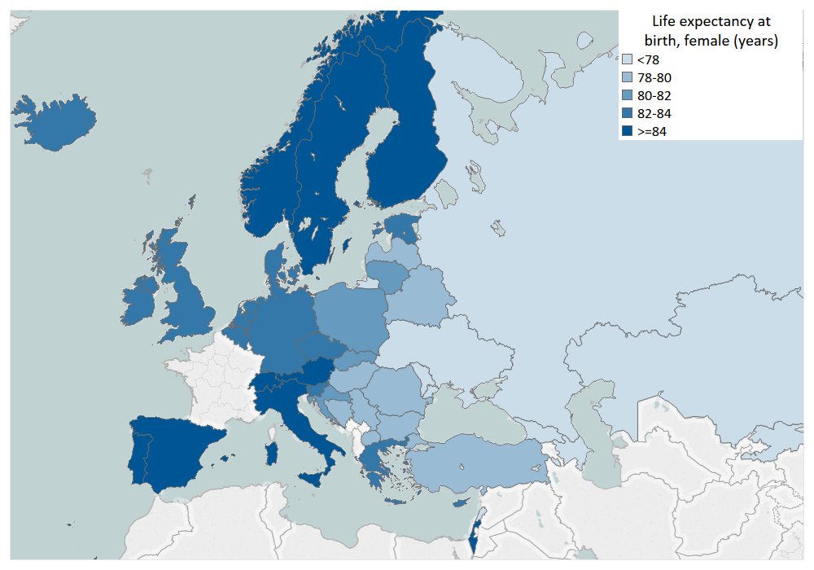
Life expectancy at birth, female (years), 2016 or latest year
Source: WHO.

Slide 14
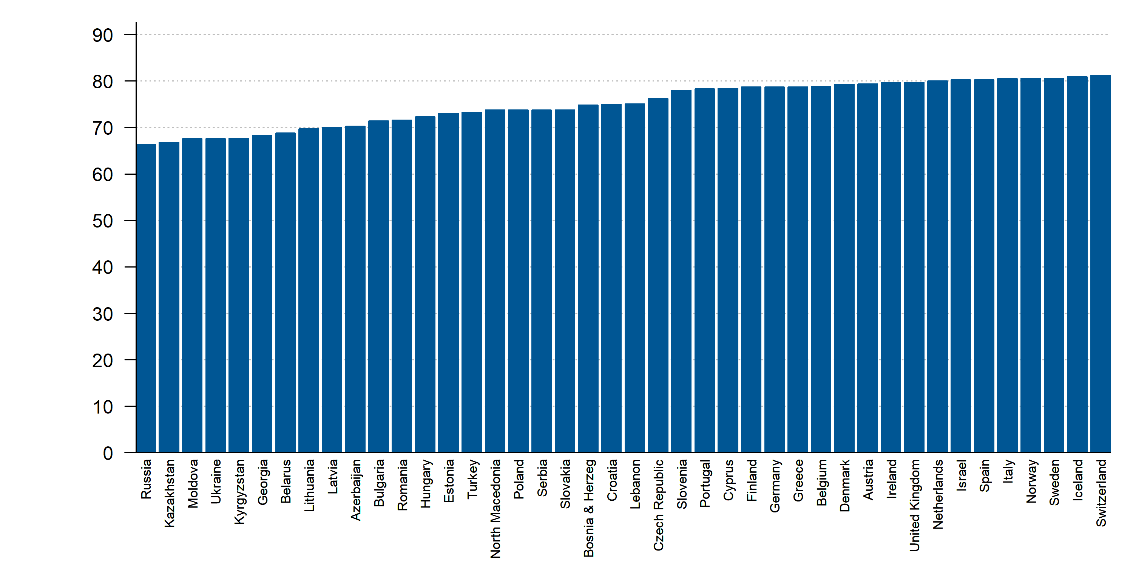
Life expectancy at birth, male (years), 2016 or latest year
Source: WHO.

Slide 15
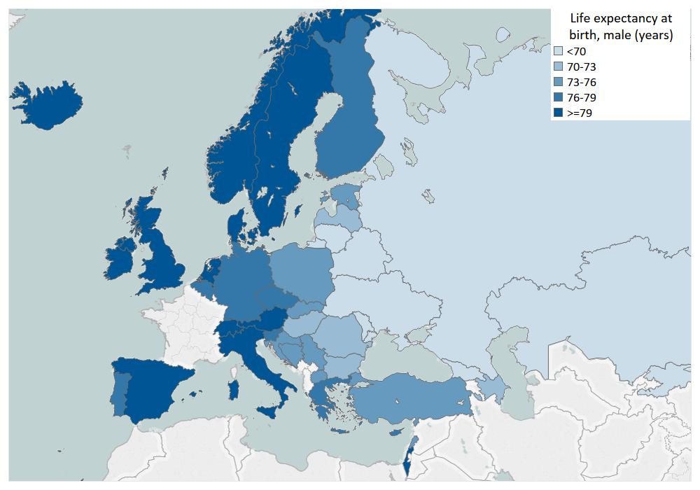
Life expectancy at birth, male (years), 2016 or latest year
Source: WHO.

Slide 16
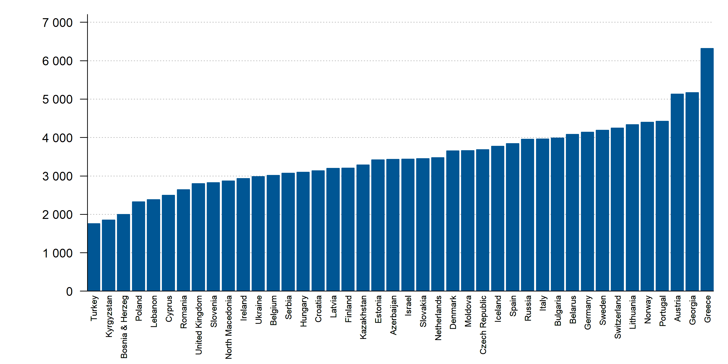
Physicians (per million people), 2016 or latest year
Source: WHO.

Slide 17
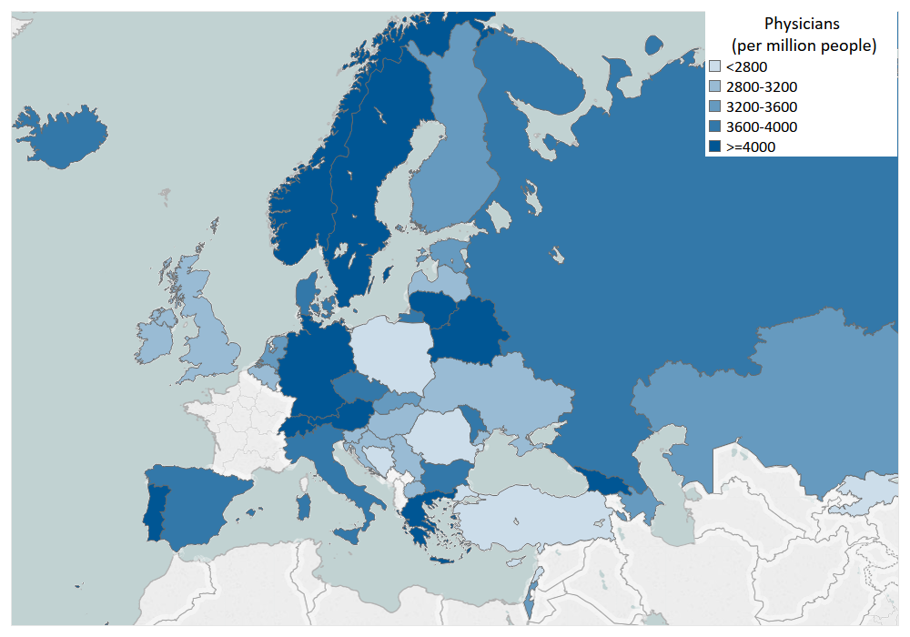
Physicians (per million people), 2016 or latest year
Source: WHO.

Slide 18
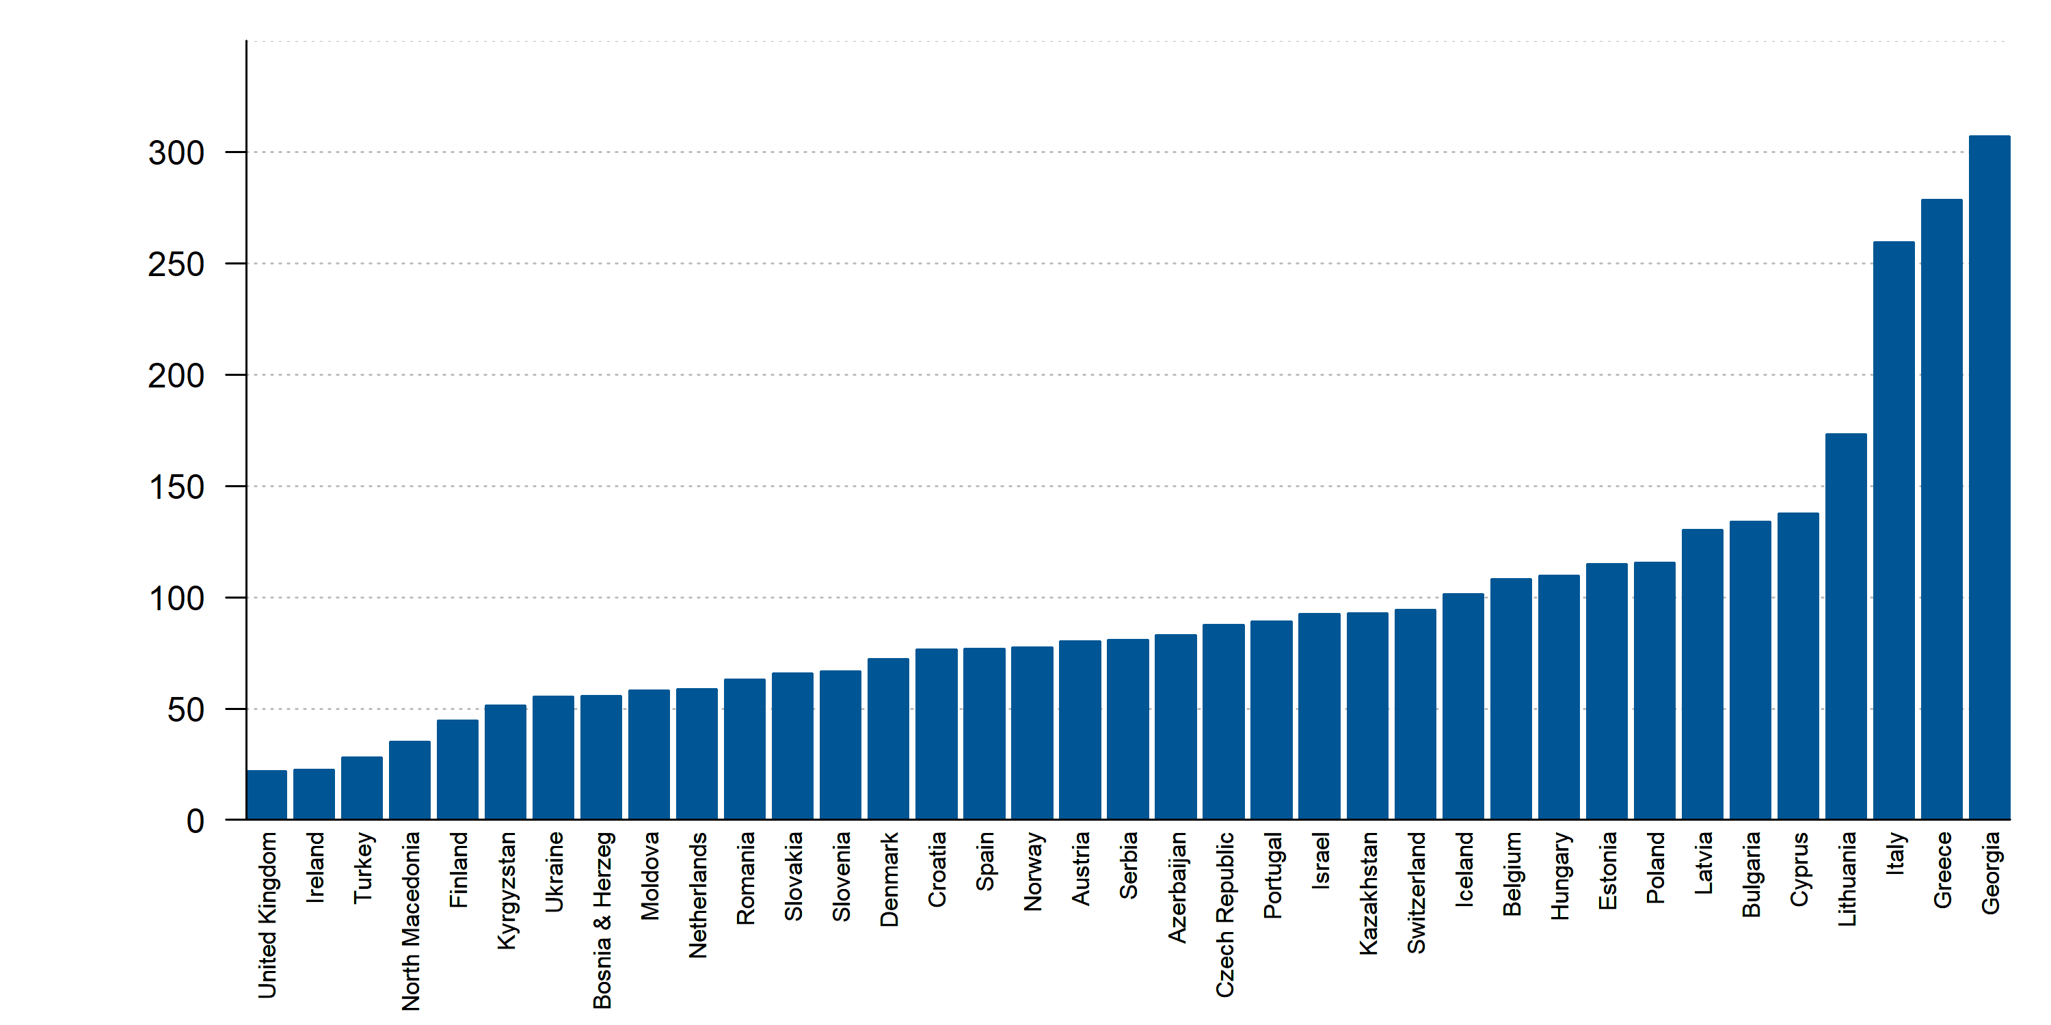
Cardiologists (per million people), 2017 or latest year
Source: ESC Survey. Missing: Belarus, Germany, Lebanon, Russia, Sweden.

Slide 19
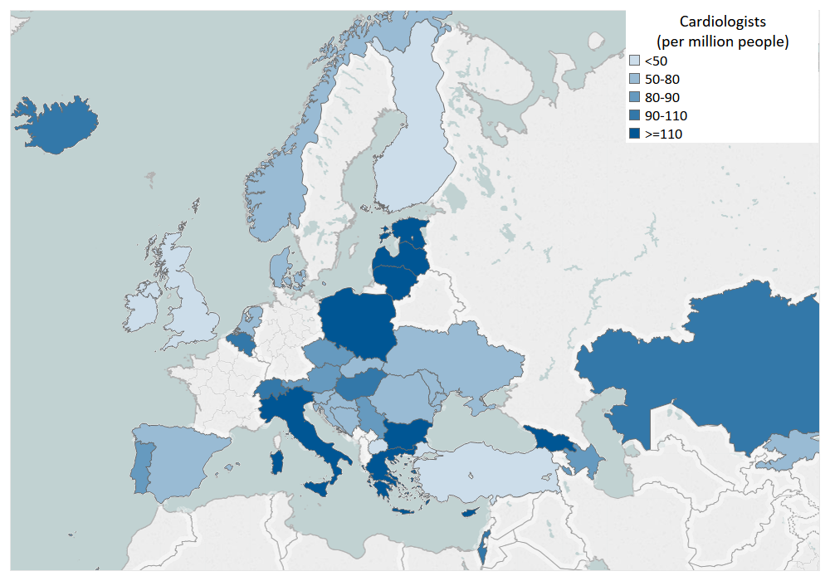
Cardiologists (per million people), 2017 or latest year
Source: ESC Survey. Missing: Belarus, Germany, Lebanon, Russia, Sweden.

Slide 20
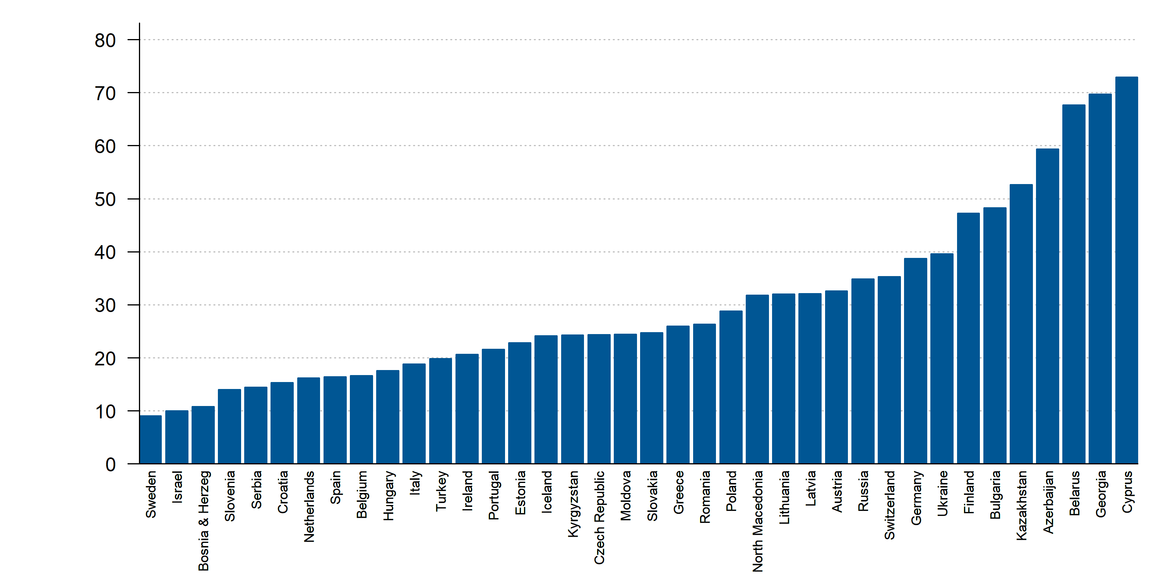
Hospitals (per million people), 2015 or latest year
Source: WHO (Health for All). Missing: Denmark, Lebanon, Norway, United Kingdom.

Slide 21
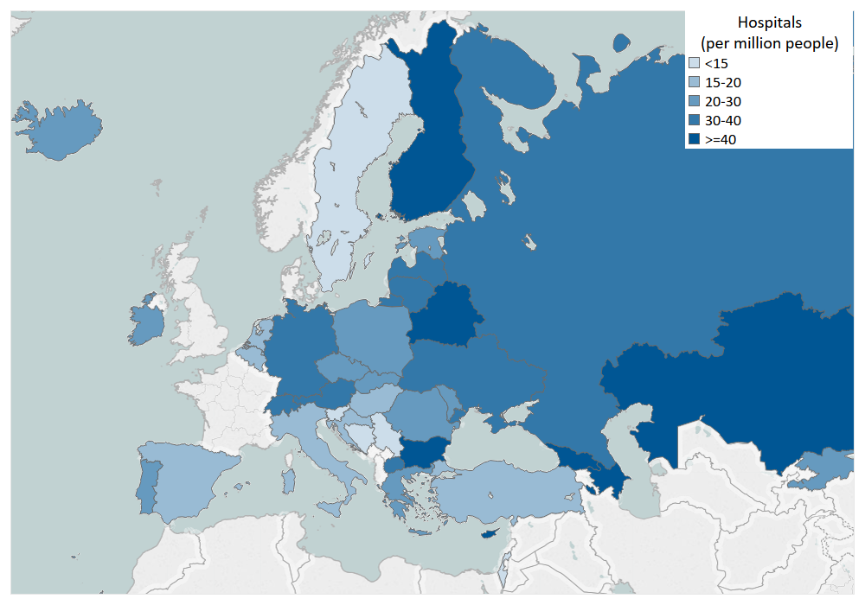
Hospitals (per million people), 2015 or latest year
Source: WHO (Health for All). Missing: Denmark, Lebanon, Norway, United Kingdom.

Slide 22
Heart Failure Epidemiology

Slide 23
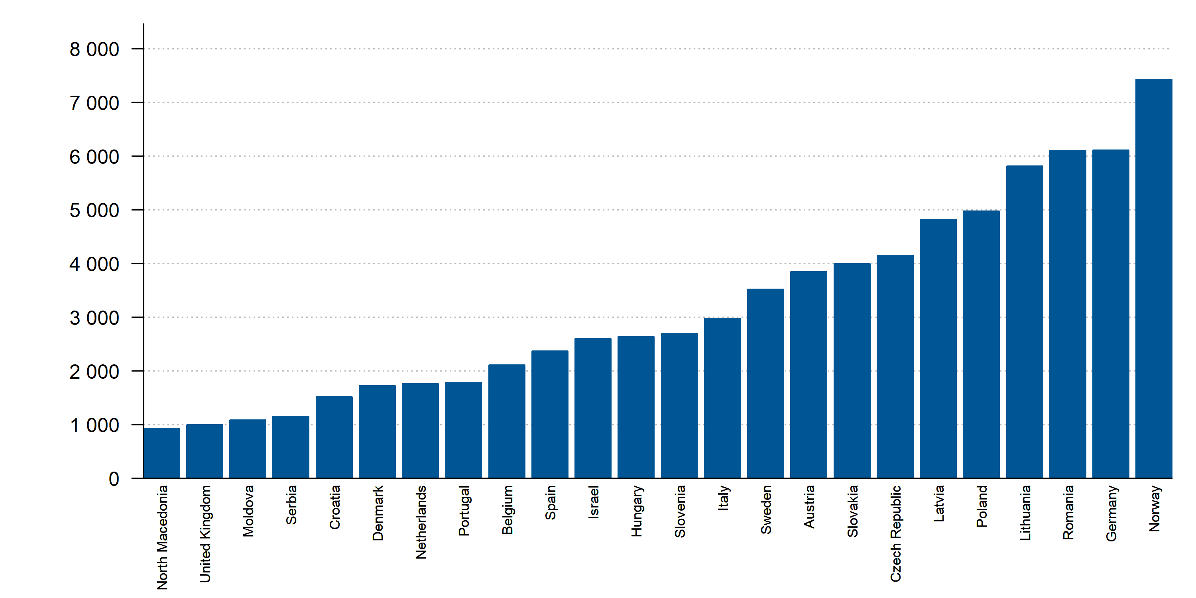
Number of HF-related hospital discharges (per million people), 2019 or latest year
Source: HFA Survey. Missing: Azerbaijan, Belarus, Bosnia and Herzegovina, Bulgaria, Cyprus, Estonia, Finland, Georgia, Greece, Iceland, Ireland, Kazakhstan, Kyrgyzstan, Lebanon, Russia, Switzerland, Turkey, Ukraine.

Slide 24
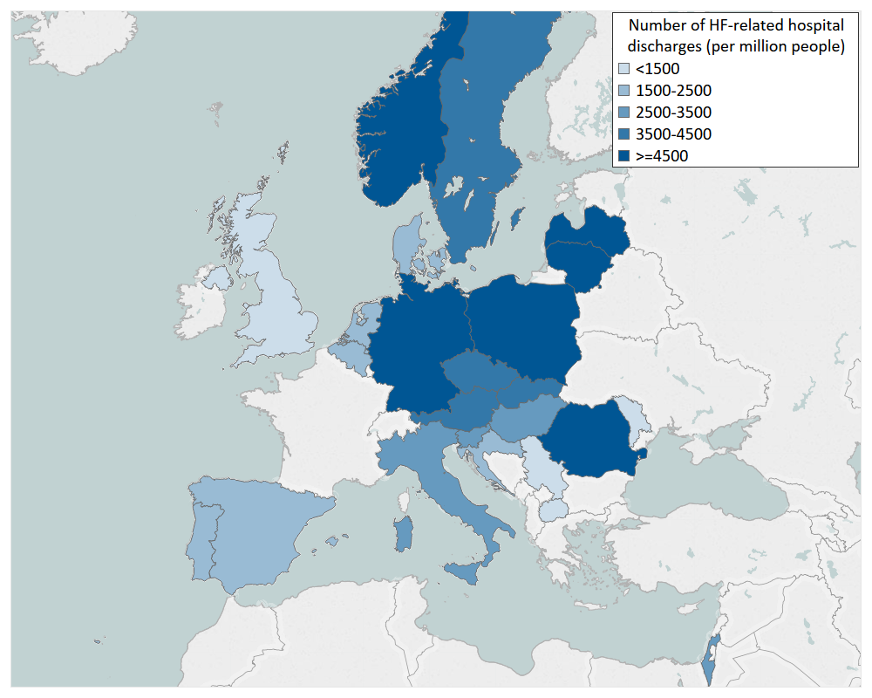
Number of HF-related hospital discharges (per million people), 2019 or latest year
Source: HFA Survey. Missing: Azerbaijan, Belarus, Bosnia and Herzegovina, Bulgaria, Cyprus, Estonia, Finland, Georgia, Greece, Iceland, Ireland, Kazakhstan, Kyrgyzstan, Lebanon, Russia, Switzerland, Turkey, Ukraine.

Slide 25
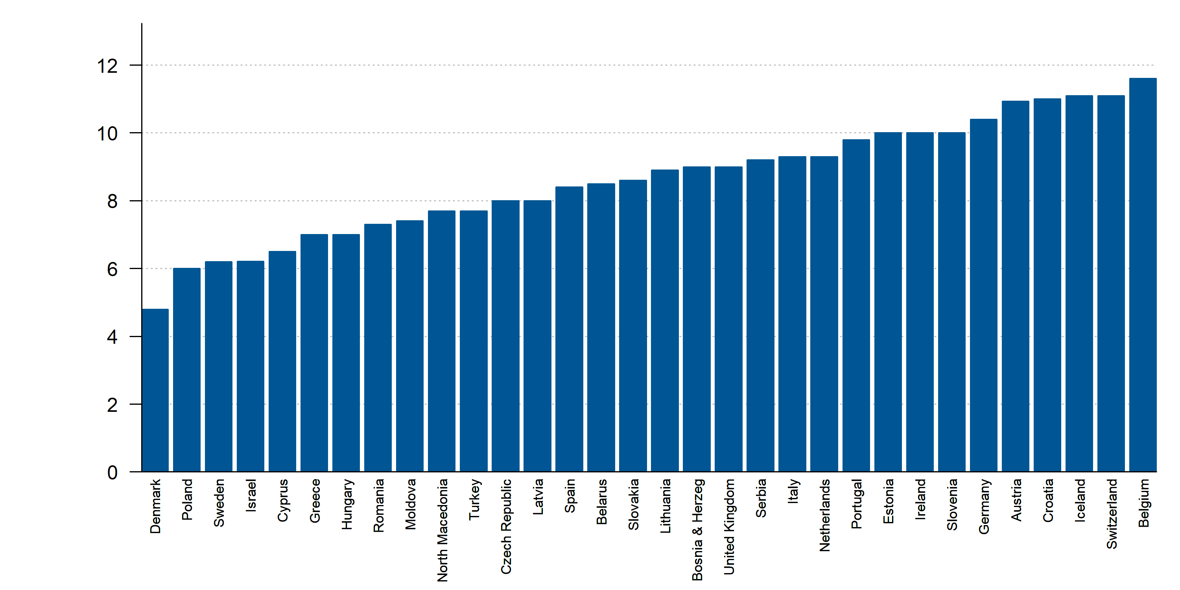
Average length of stay in hospital primarily due to HF, 2019 or latest year
Source: HFA Survey. Missing: Azerbaijan, Bulgaria, Finland, Georgia, Kazakhstan, Kyrgyzstan, Lebanon, Norway, Russia, Ukraine.

Slide 26
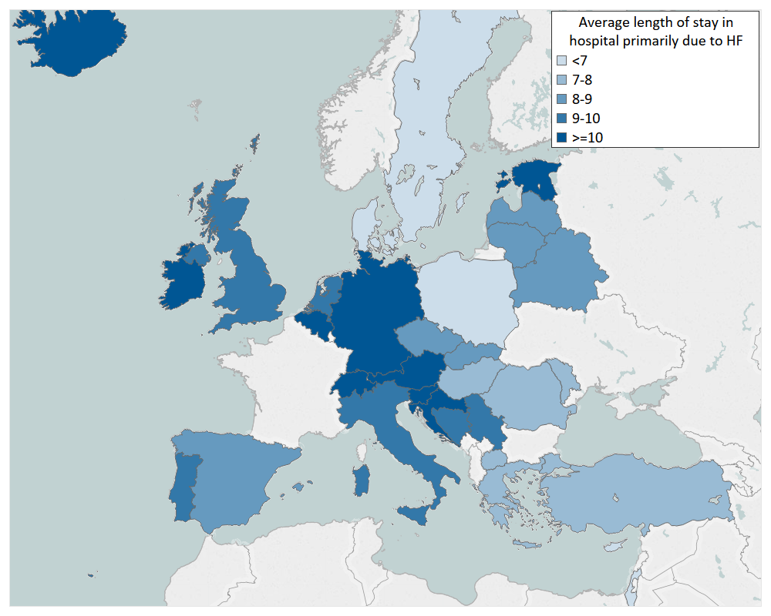
Average length of stay in hospital primarily due to HF, 2019 or latest year
Source: HFA Survey. Missing: Azerbaijan, Bulgaria, Finland, Georgia, Kazakhstan, Kyrgyzstan, Lebanon, Norway, Russia, Ukraine.

Slide 27
Healthcare Resources with Focus on Heart Failure

Slide 28
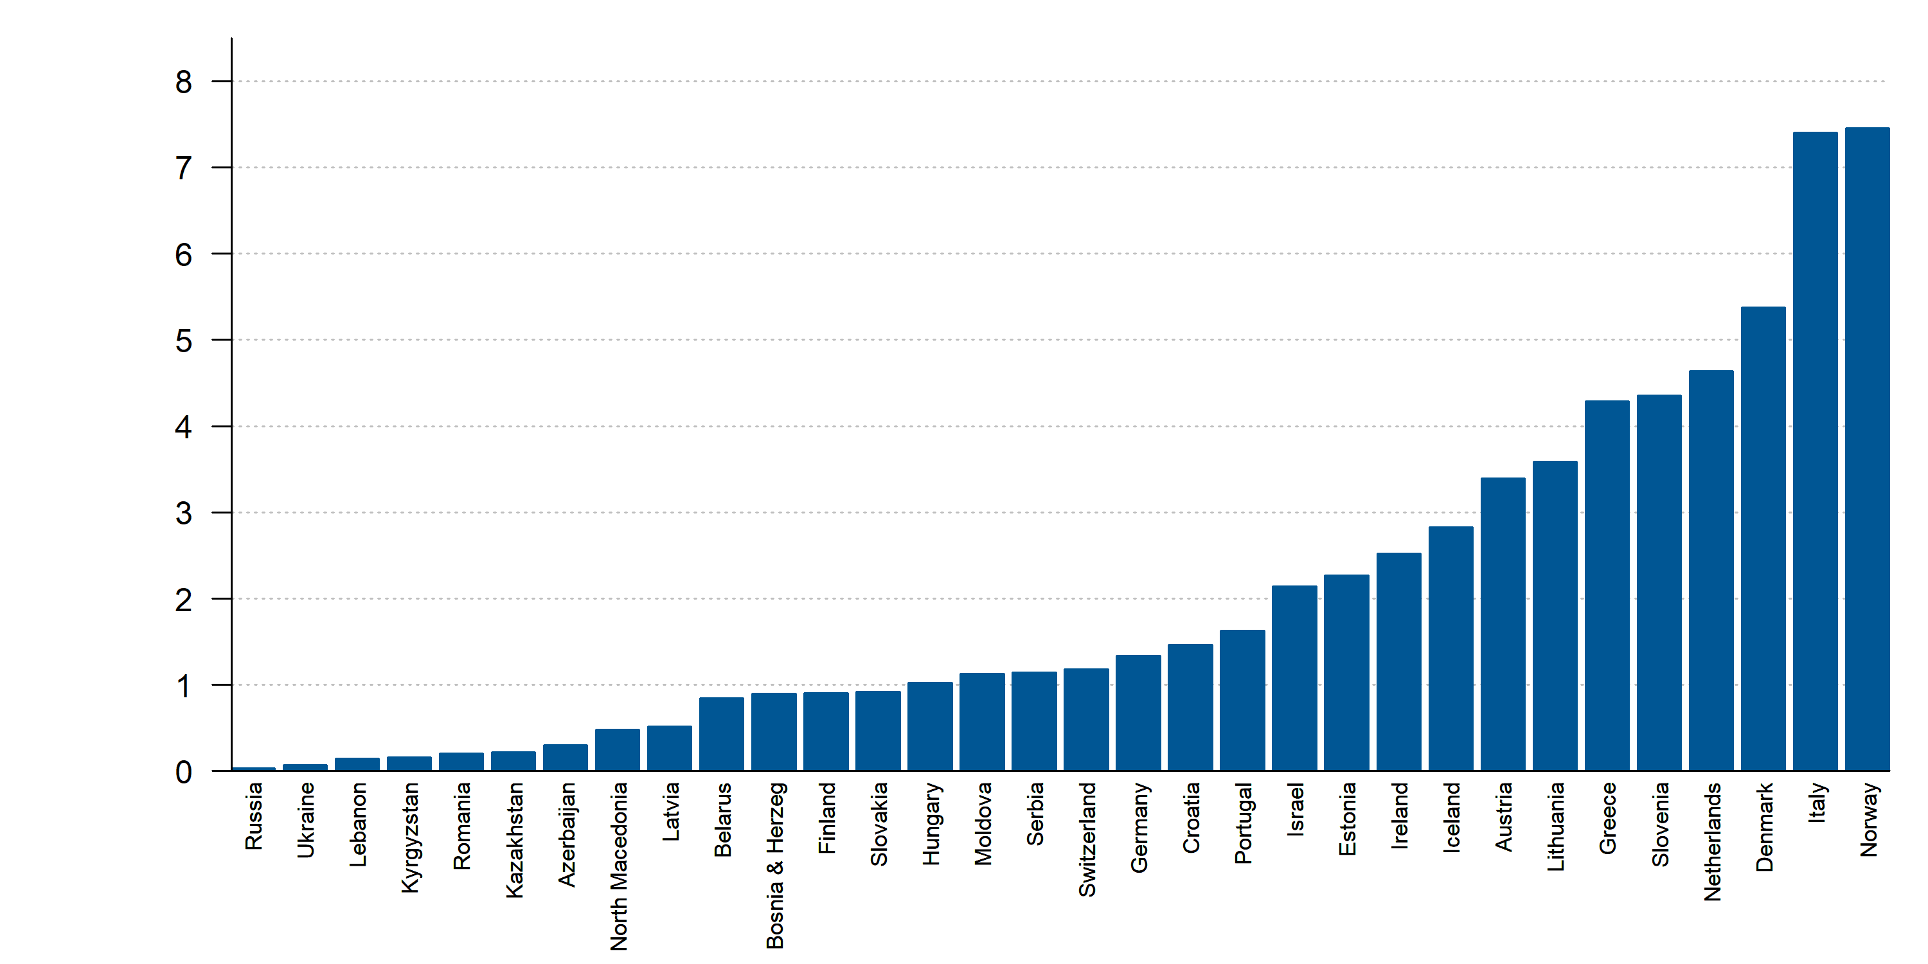
Hospitals with dedicated HF centers (per million people), 2018 or latest year
Source: HFA Survey. Missing: Belgium, Bulgaria, Cyprus, Czech Republic, Georgia, Poland, Spain, Sweden, Turkey, United Kingdom.

Slide 29
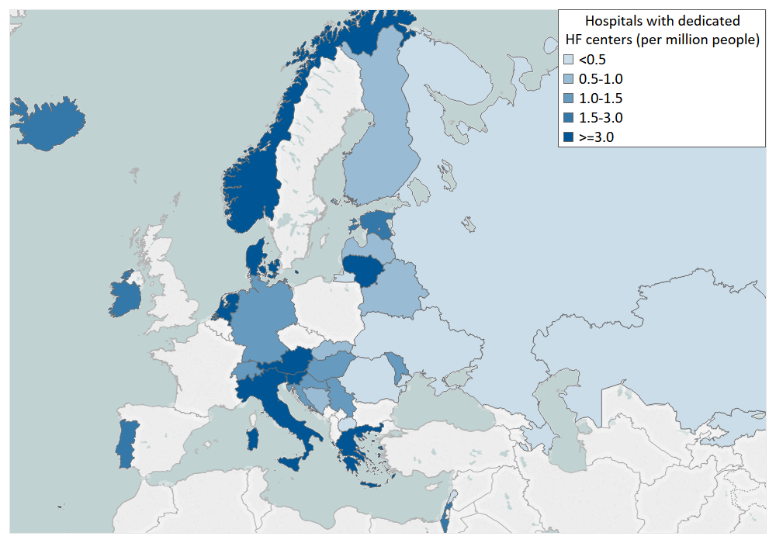
Hospitals with dedicated HF centers (per million people), 2018 or latest year
Source: HFA Survey. Missing: Belgium, Bulgaria, Cyprus, Czech Republic, Georgia, Poland, Spain, Sweden, Turkey, United Kingdom.

Slide 30
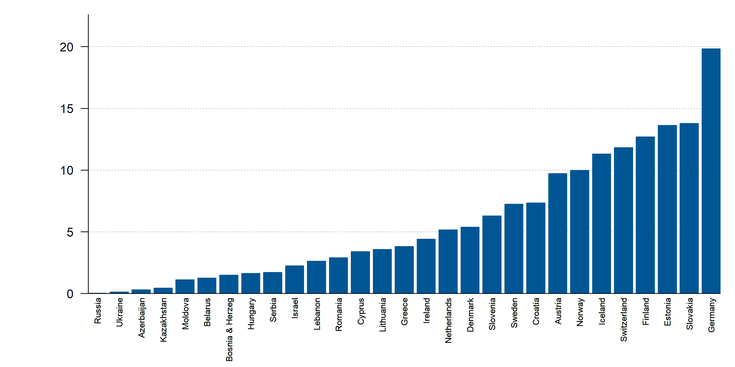
Hospitals with availability to obtain BNP (NT-proBNP) in ER (per million people), 2018 or latest year
Source: HFA Survey. Missing: Belgium, Bulgaria, Czech Republic, Georgia, Italy, Latvia, Poland, Portugal, Spain, Turkey, United Kingdom. Resource not available: Kyrgyzstan, North Macedonia.

Slide 31
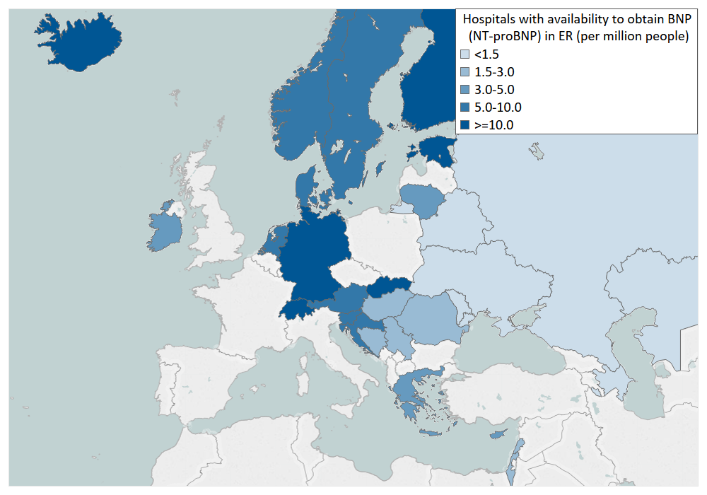
Hospitals with availability to obtain BNP (NT-proBNP) in ER (per million people), 2018 or latest year
Source: HFA Survey. Missing: Belgium, Bulgaria, Czech Republic, Georgia, Italy, Latvia, Poland, Portugal, Spain, Turkey, United Kingdom. Resource not available: Kyrgyzstan, North Macedonia.

Slide 32
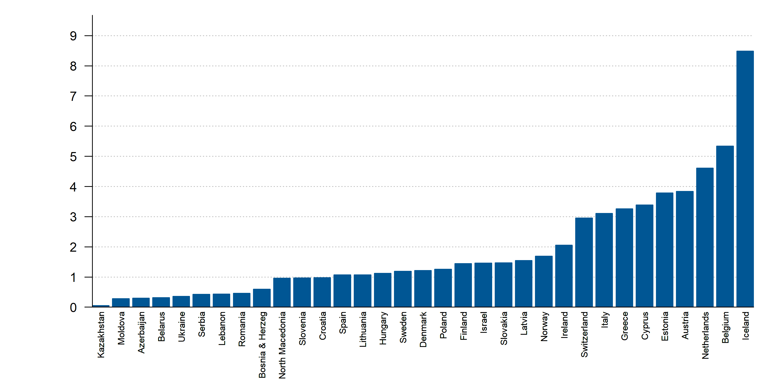
Cardiac MRI units (per million people), 2018 or latest year
Source: HFA Survey. Missing: Bulgaria, Czech Republic, Georgia, Germany, Portugal, Russia, Turkey, United Kingdom. Resource not available: Kyrgyzstan.

Slide 33
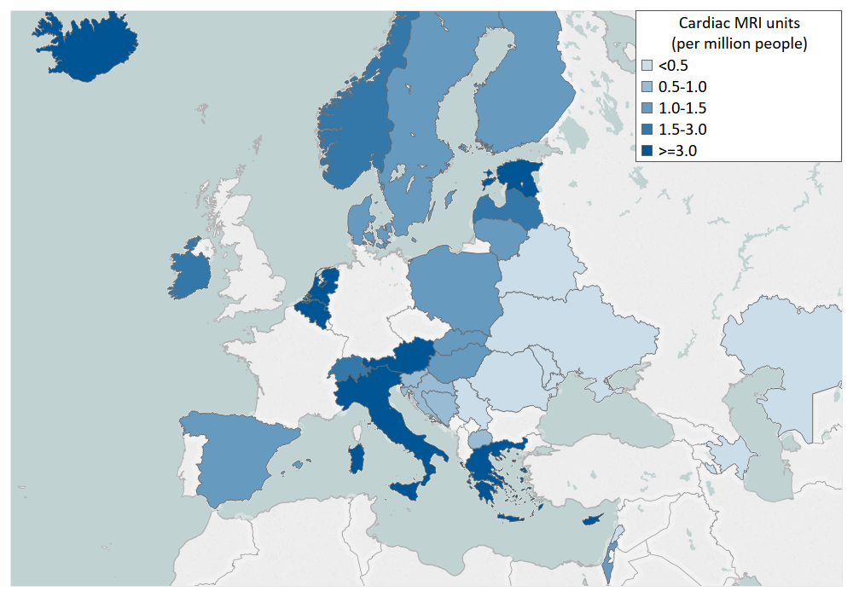
Cardiac MRI units (per million people), 2018 or latest year
Source: HFA Survey. Missing: Bulgaria, Czech Republic, Georgia, Germany, Portugal, Russia, Turkey, United Kingdom. Resource not available: Kyrgyzstan.

Slide 34
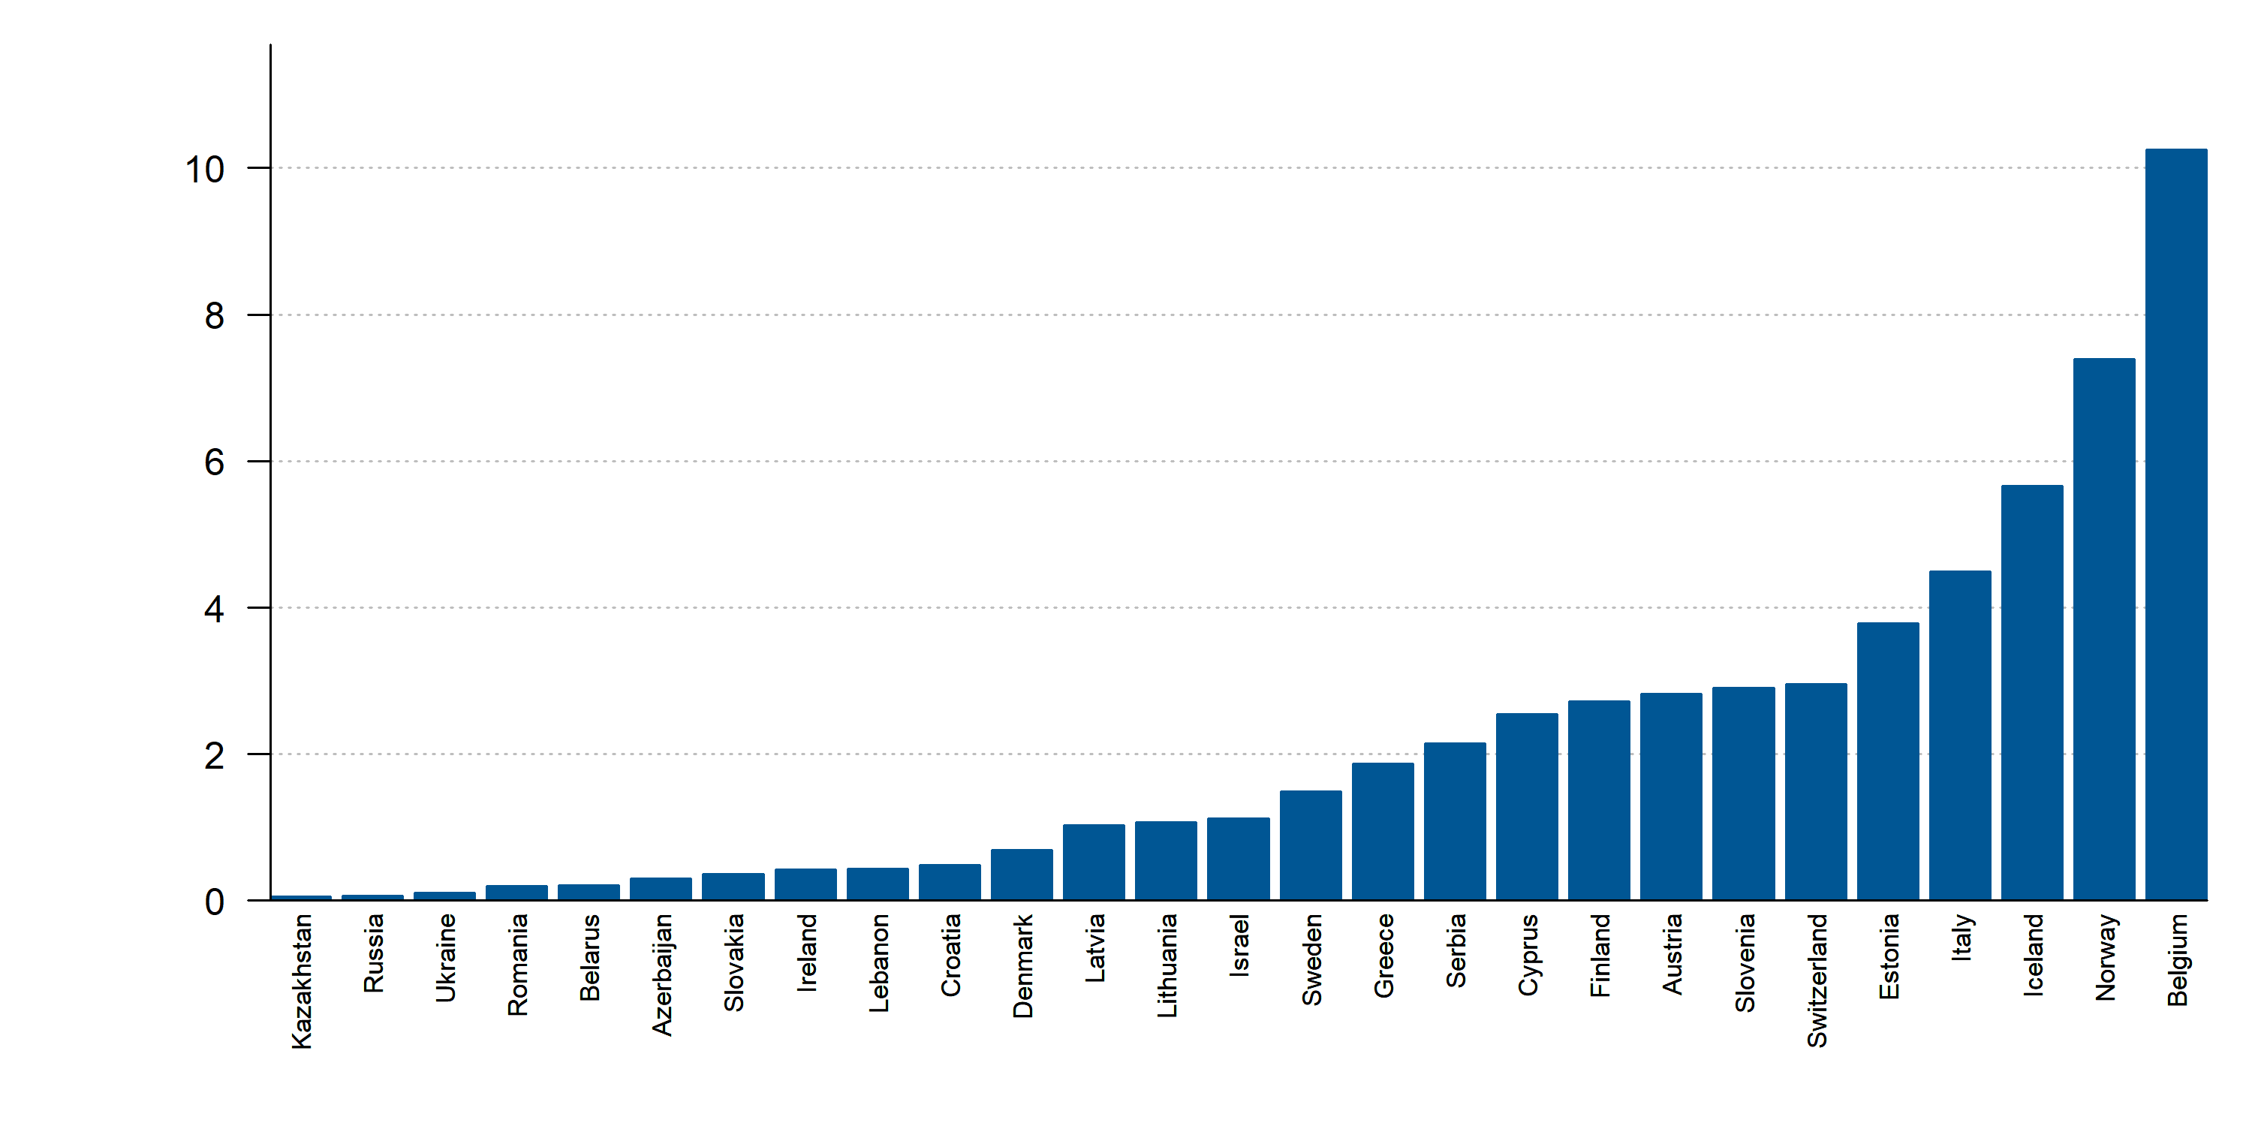
Hospitals performing spiro-ergometry (per million people), 2018 or latest year
Source: HFA Survey. Missing: Bosnia and Herzegovina, Bulgaria, Czech Republic, Georgia, Germany, Hungary, North Macedonia, Netherlands, Poland, Portugal, Spain, Turkey, United Kingdom. Resource not available: Kyrgyzstan, Moldova.

Slide 35
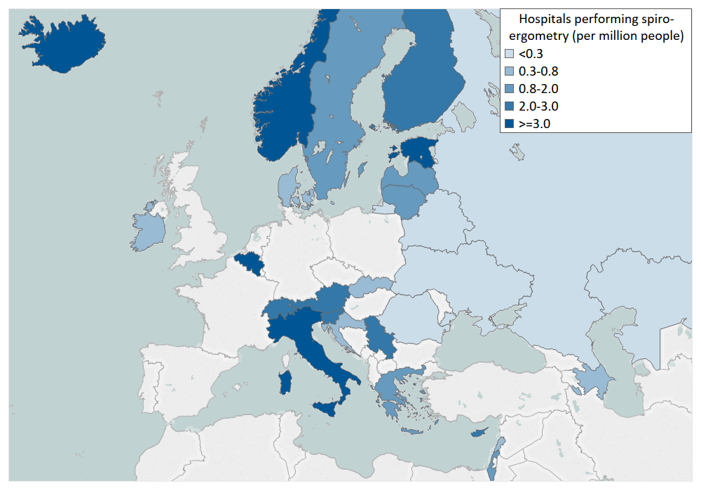
Hospitals performing spiro-ergometry (per million people), 2018 or latest year
Source: HFA Survey. Missing: Bosnia and Herzegovina, Bulgaria, Czech Republic, Georgia, Germany, Hungary, North Macedonia, Netherlands, Poland, Portugal, Spain, Turkey, United Kingdom. Resource not available: Kyrgyzstan, Moldova.

Slide 36
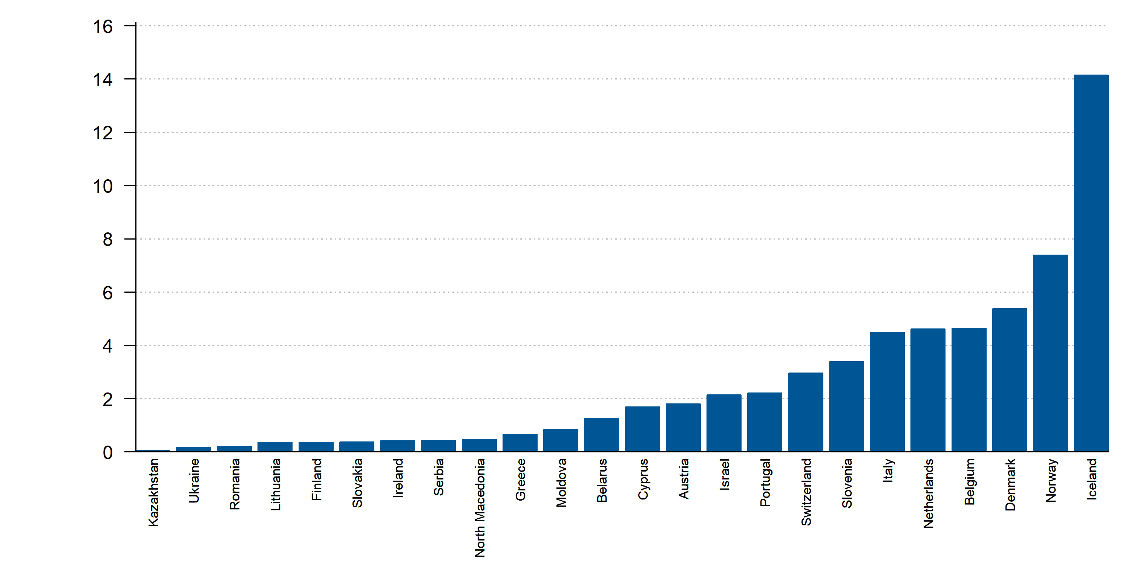
Hospitals performing HF exercise programs for HF patients (per million people), 2018 or latest year
Source: HFA Survey. Missing: Azerbaijan, Bosnia and Herzegovina, Bulgaria, Croatia, Czech Republic, Georgia, Germany, Hungary, Latvia, Poland, Russia, Spain, Sweden, Turkey, United Kingdom. Resource not available: Estonia, Kyrgyzstan, Lebanon.

Slide 37
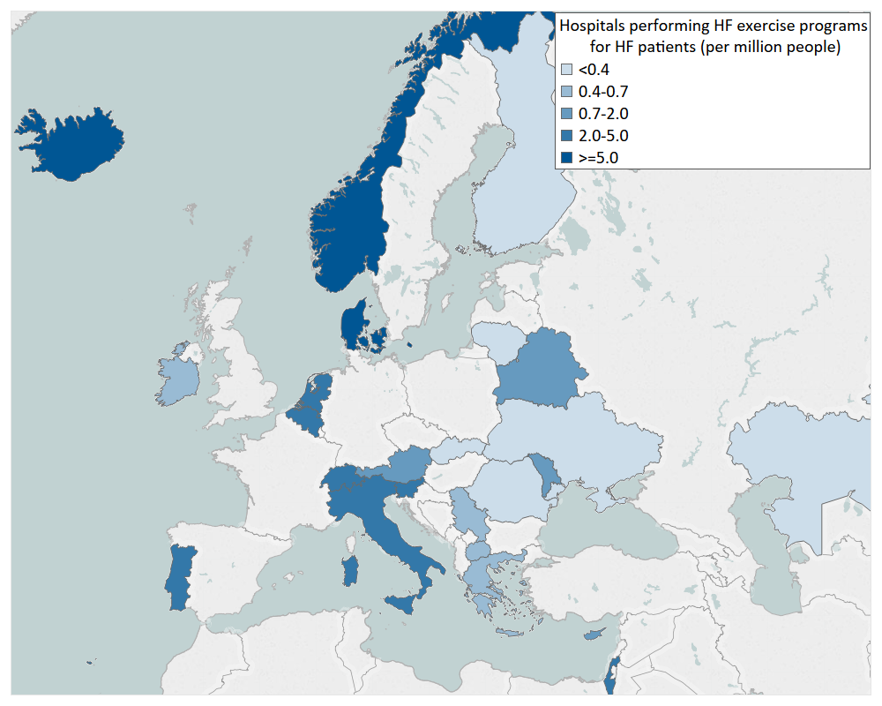
Hospitals performing HF exercise programs for HF patients (per million people), 2018 or latest year
Source: HFA Survey. Missing: Azerbaijan, Bosnia and Herzegovina, Bulgaria, Croatia, Czech Republic, Georgia, Germany, Hungary, Latvia, Poland, Russia, Spain, Sweden, Turkey, United Kingdom. Resource not available: Estonia, Kyrgyzstan, Lebanon.

Slide 38
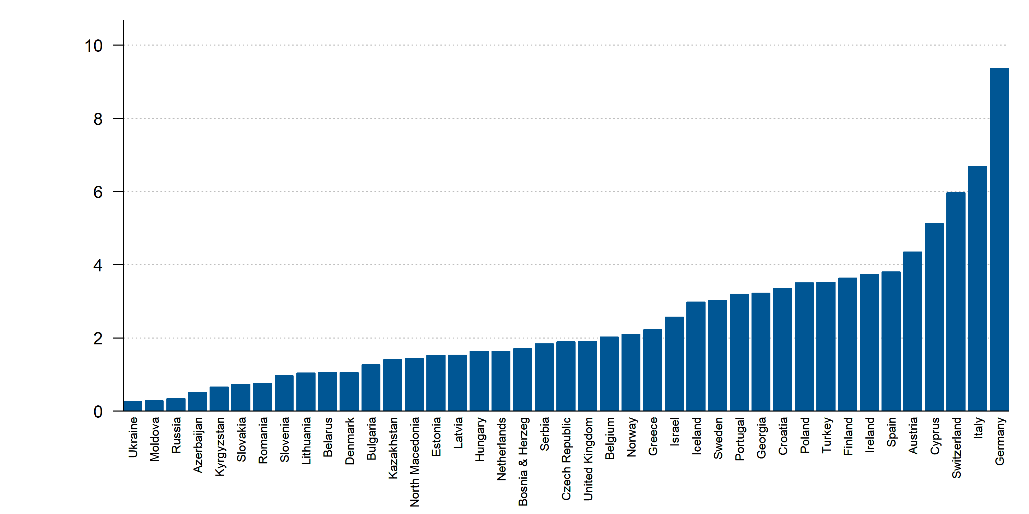
Hospitals implanting implantable cardioverter defibrillators (ICD) (per million people), 2017 or latest year
Source: EHRA White Book, ESC Survey. Missing: Lebanon.

Slide 39
Hospitals implanting implantable cardioverter defibrillators (ICD) (per million people), 2017 or latest year
Source: EHRA White Book, ESC Survey. Missing: Lebanon.

Slide 40
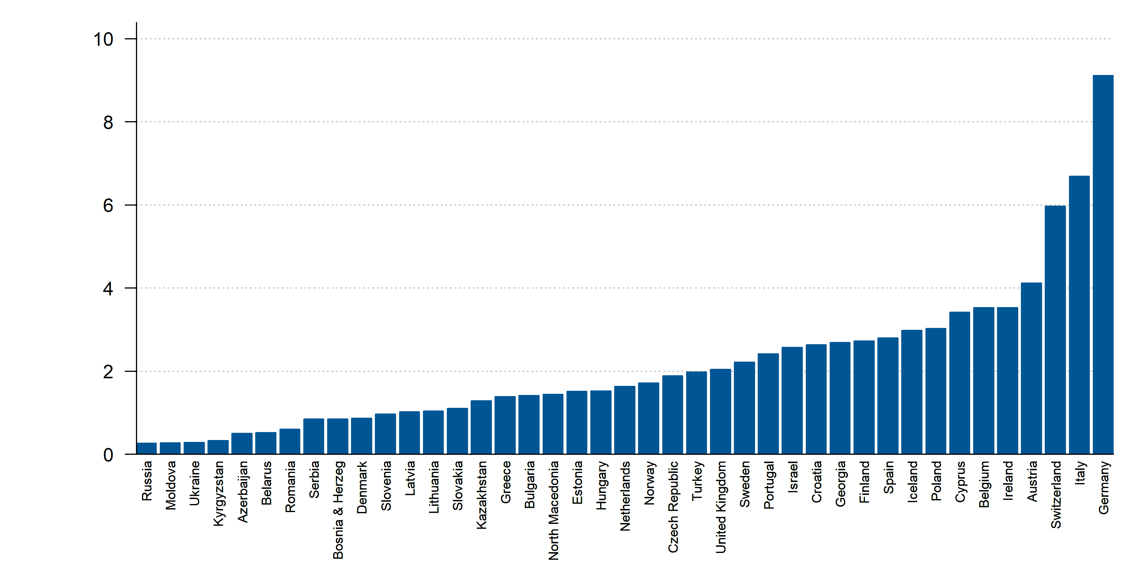
Hospitals implanting cardiac resynchronization therapy (CRT) devices (per million people), 2017 or latest year
Source: EHRA White Book, ESC Survey. Missing: Lebanon.

Slide 41
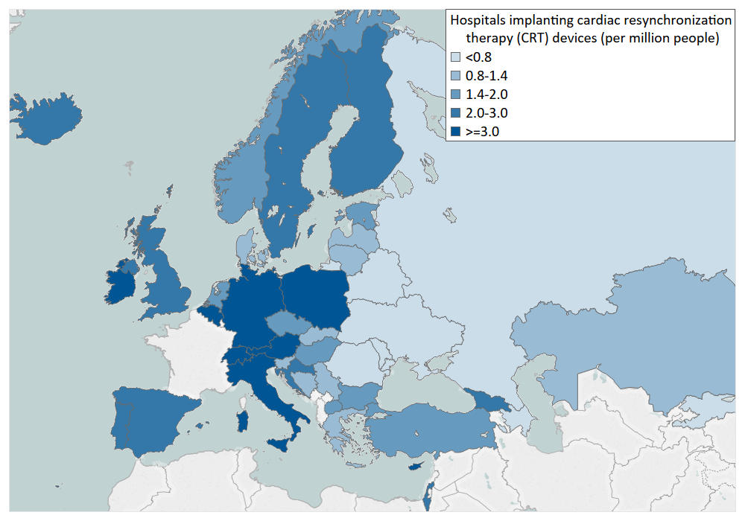
Hospitals implanting cardiac resynchronization therapy (CRT) devices (per million people), 2017 or latest year
Source: EHRA White Book, ESC Survey. Missing: Lebanon.

Slide 42
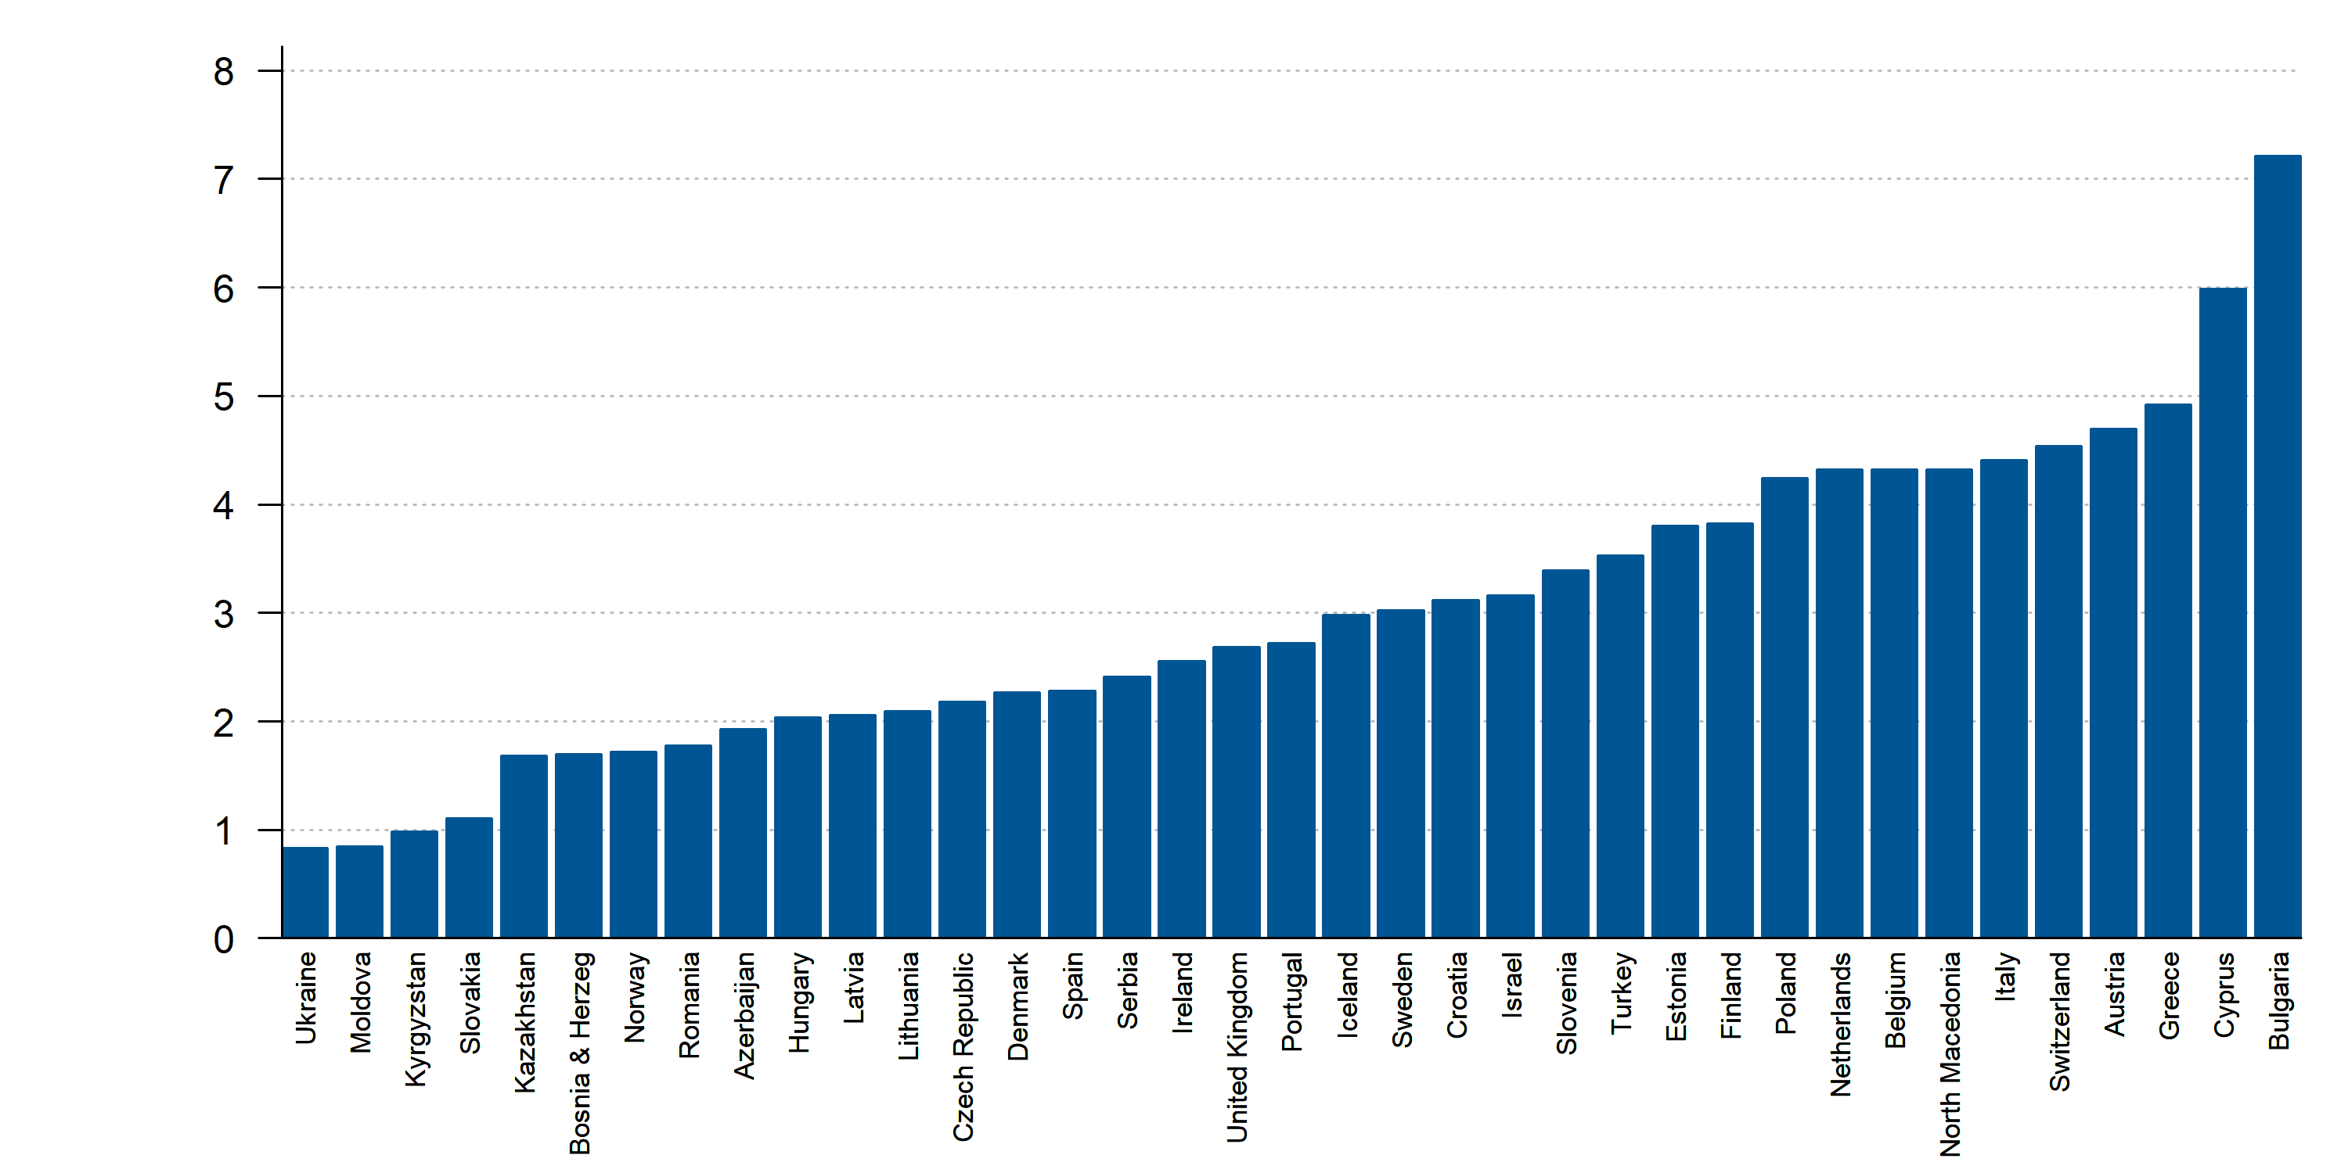
Hospitals with cath labs (per million people), 2017 or latest year
Source: ESC Survey, EAPCI survey. Missing: Belarus, Georgia, Germany, Lebanon, Russia.

Slide 43
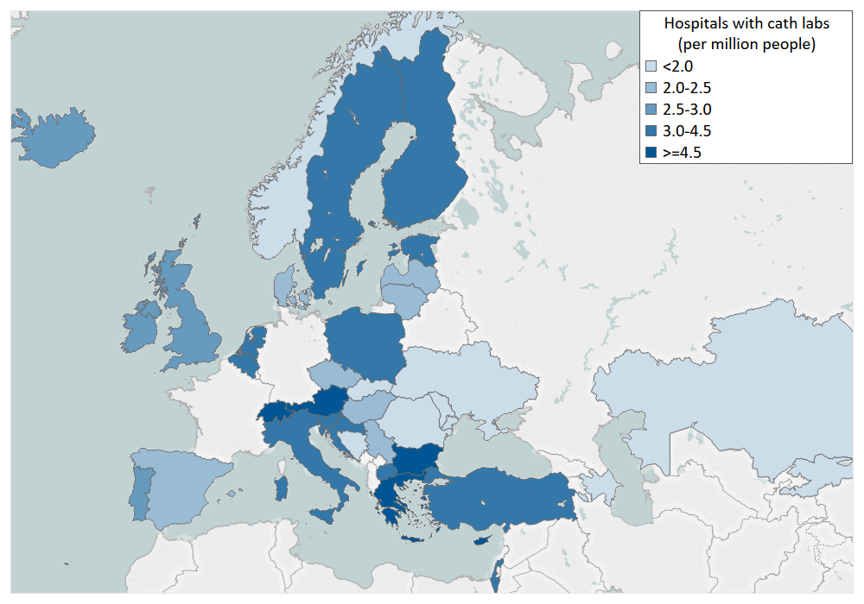
Hospitals with cath labs (per million people), 2017 or latest year
Source: ESC Survey, EAPCI survey. Missing: Belarus, Georgia, Germany, Lebanon, Russia.

Slide 44
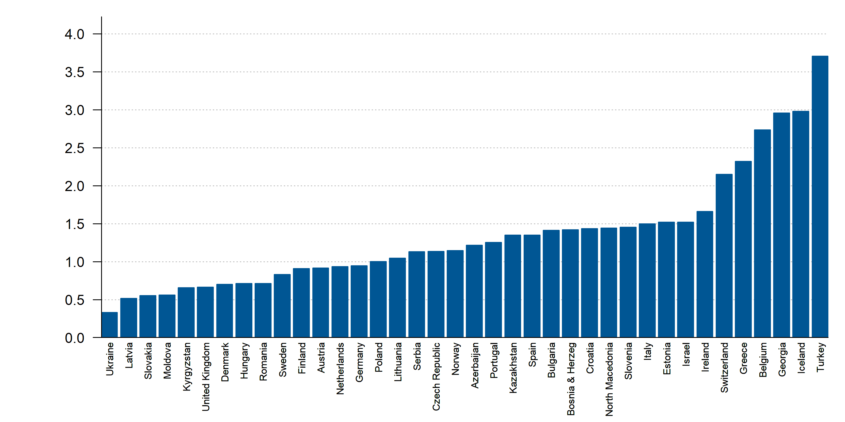
Hospitals with cardiac surgery (per million people), 2017 or latest year
Source: ESC Survey. Missing: Belarus, Cyprus, Lebanon, Russia.

Slide 45
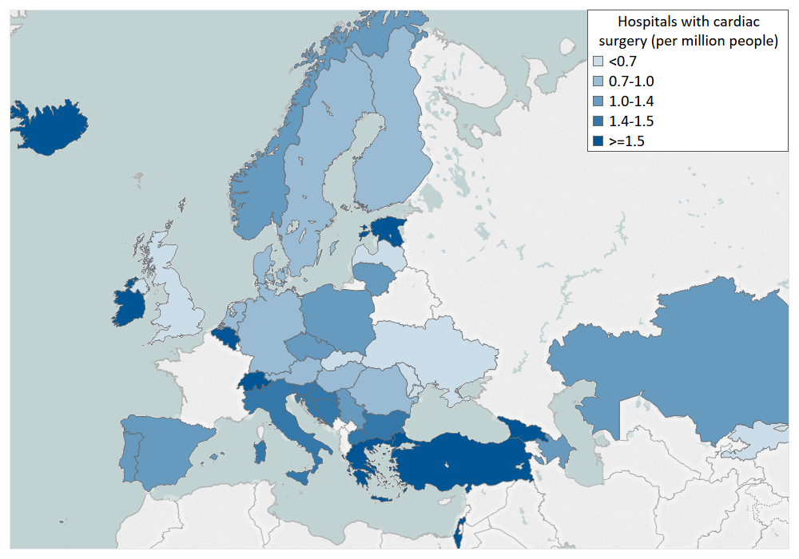
Hospitals with cardiac surgery (per million people), 2017 or latest year
Source: ESC Survey. Missing: Belarus, Cyprus, Lebanon, Russia.

Slide 46
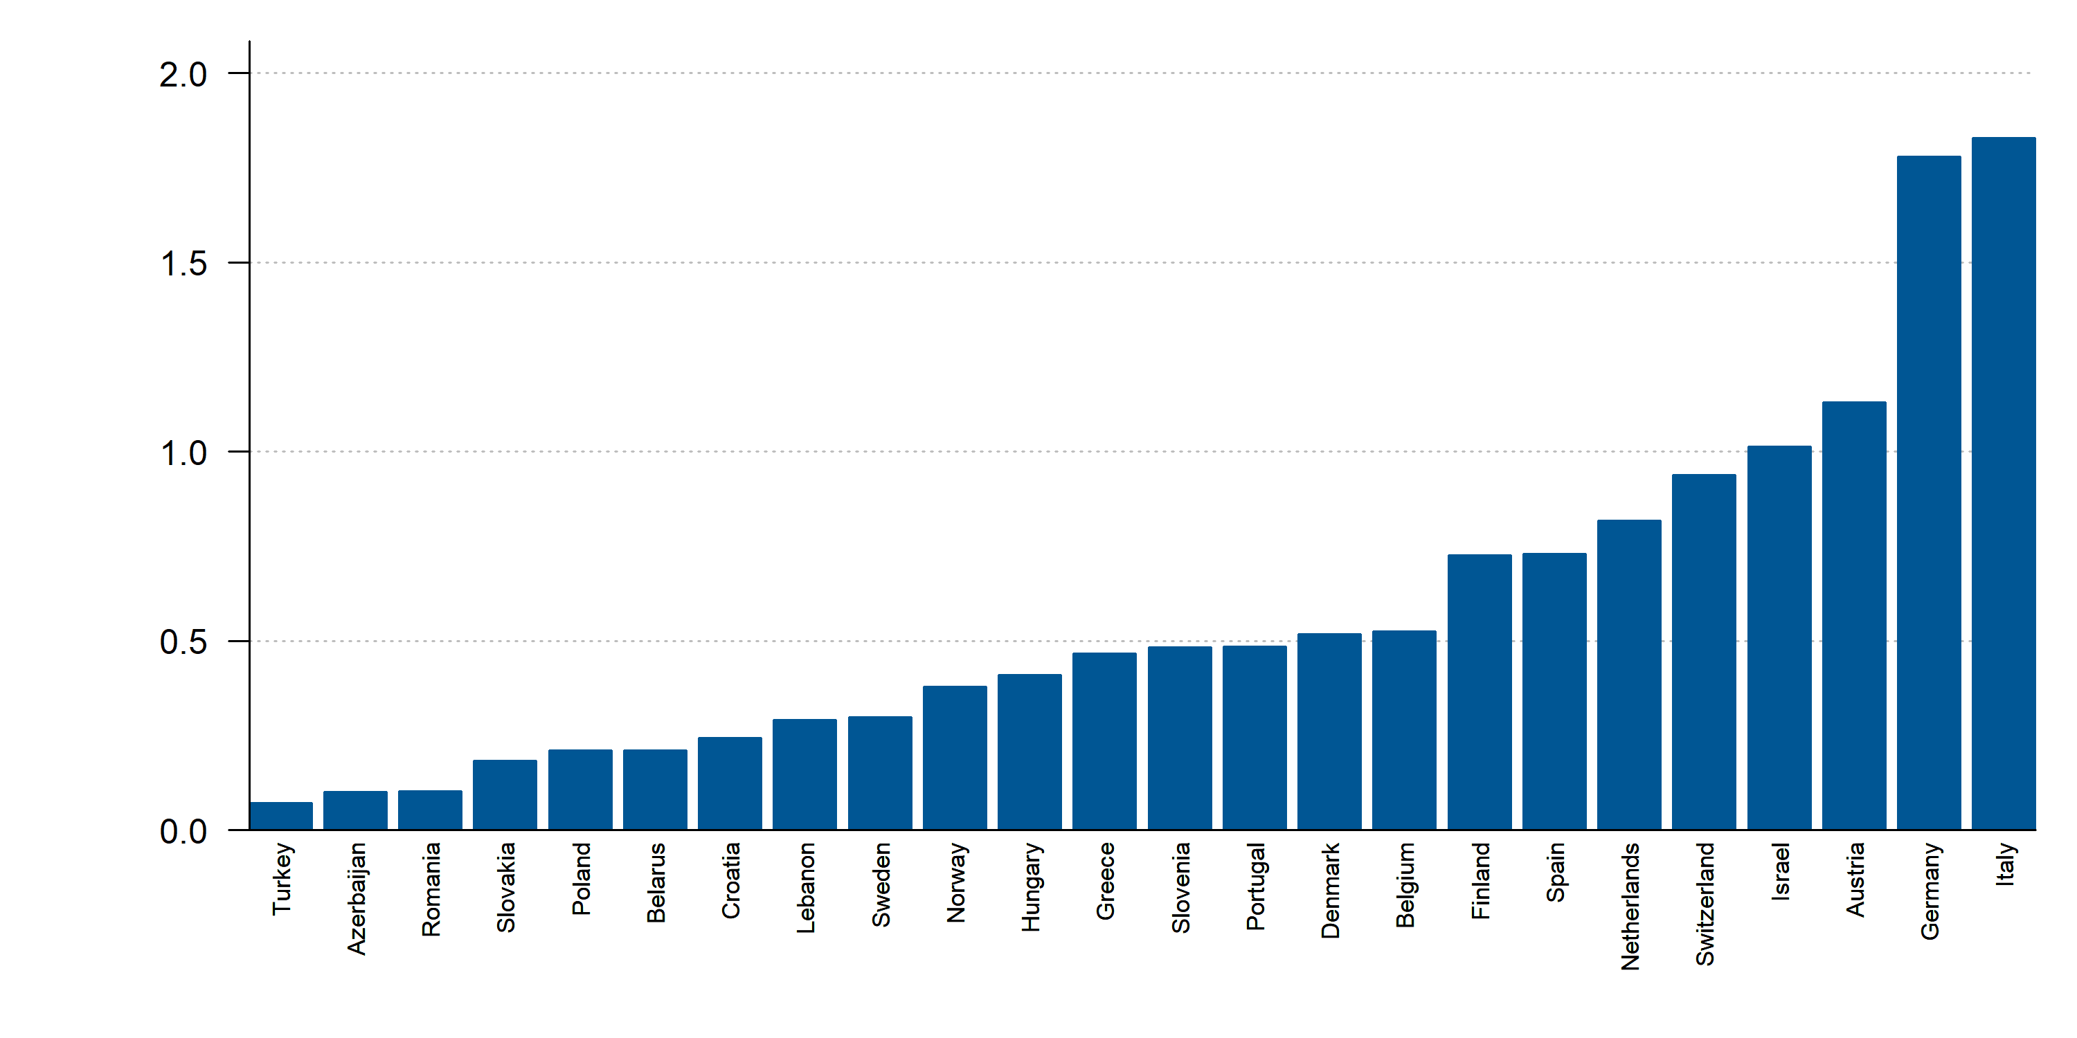
Hospitals implanting Mitraclip (per million people), 2018 or latest year
Source: HFA Survey. Missing: Bosnia and Herzegovina, Bulgaria, Cyprus, Czech Republic, Georgia, Ireland, Latvia, Russia, United Kingdom. Resource not available: Estonia, Iceland, Kazakhstan, Kyrgyzstan, Lithuania, North Macedonia, Moldova, Serbia, Ukraine.

Slide 47
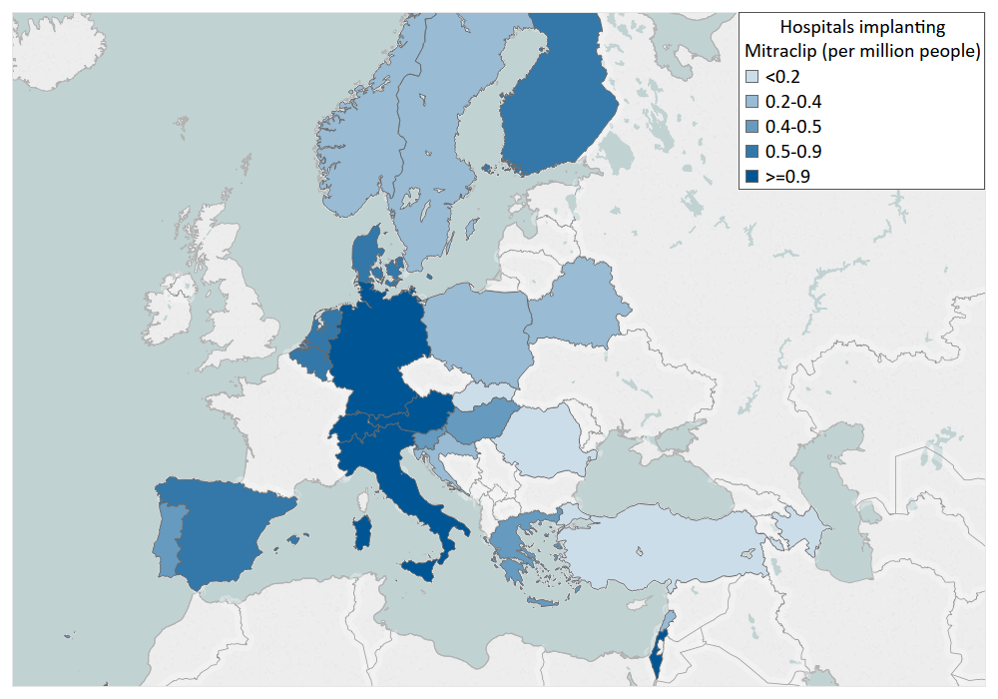
Hospitals implanting Mitraclip (per million people), 2018 or latest year
Source: HFA Survey. Missing: Bosnia and Herzegovina, Bulgaria, Cyprus, Czech Republic, Georgia, Ireland, Latvia, Russia, United Kingdom. Resource not available: Estonia, Iceland, Kazakhstan, Kyrgyzstan, Lithuania, North Macedonia, Moldova, Serbia, Ukraine.

Slide 48
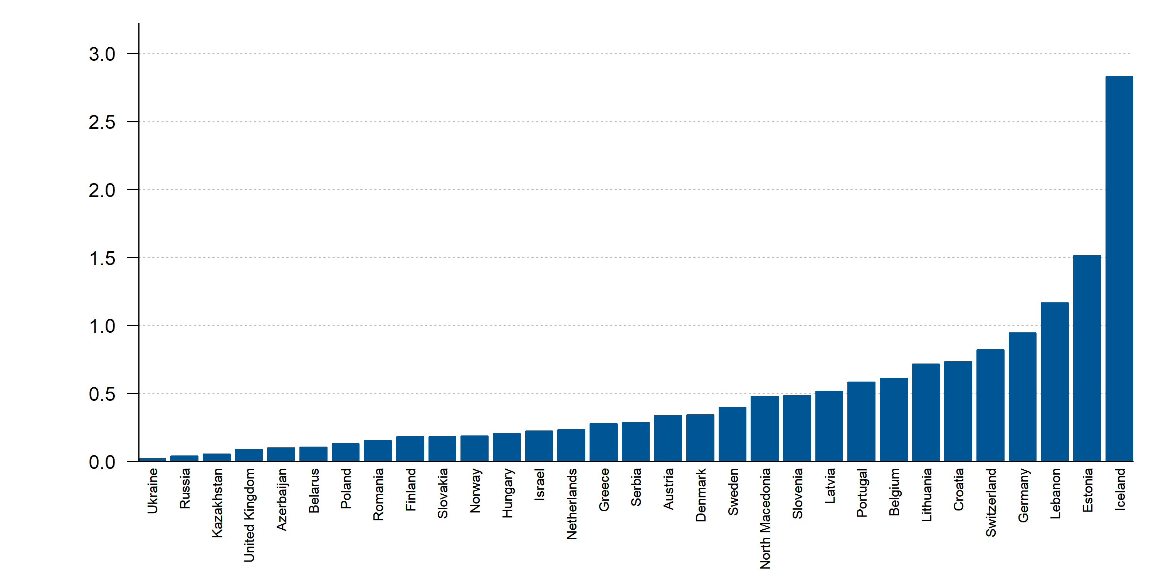
Hospitals implanting left ventricular assist devices (LVAD) (per million people), 2018 or latest year
Source: HFA Survey. Missing: Bosnia and Herzegovina, Bulgaria, Czech Republic, Georgia, Ireland, Italy, Spain, Turkey. Resource not available: Cyprus, Kyrgyzstan, Moldova.

Slide 49
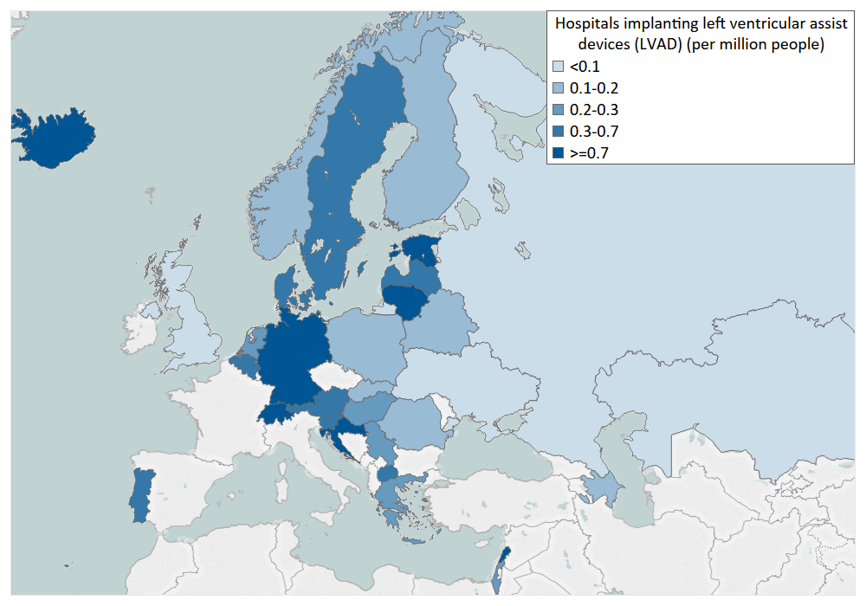
Hospitals implanting left ventricular assist devices (LVAD) (per million people), 2018 or latest year
Source: HFA Survey. Missing: Bosnia and Herzegovina, Bulgaria, Czech Republic, Georgia, Ireland, Italy, Spain, Turkey. Resource not available: Cyprus, Kyrgyzstan, Moldova.

Slide 50
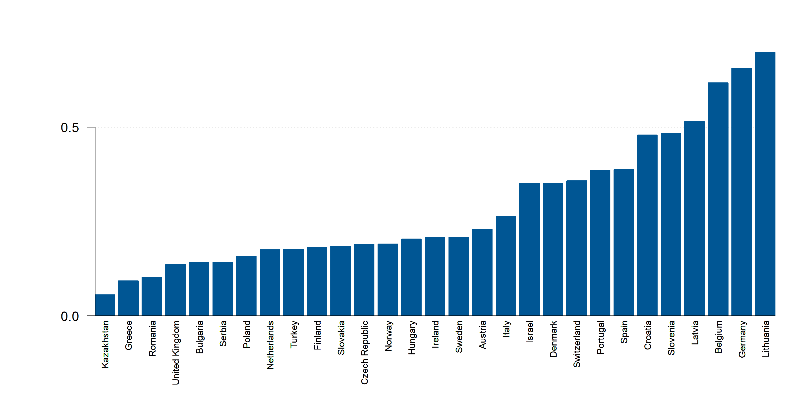
Hospitals with cardiac transplantation program (per million people), 2017 or latest year
Source: ESC Survey. Missing: Belarus, Lebanon, Russia. Resource not available: Azerbaijan, Bosnia and Herzegovina, Cyprus, Estonia, Georgia, Iceland, Kyrgyzstan, North Macedonia, Moldova, Ukraine.

Slide 51
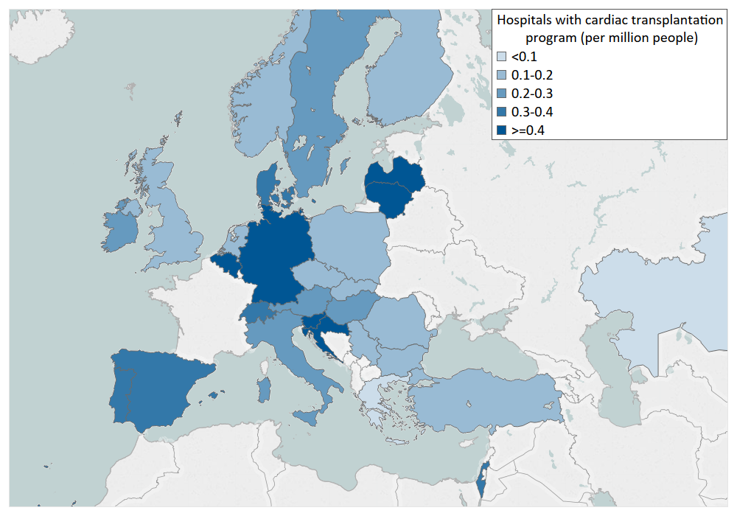
Hospitals with cardiac transplantation program (per million people), 2017 or latest year
Source: ESC Survey. Missing: Belarus, Lebanon, Russia. Resource not available: Azerbaijan, Bosnia and Herzegovina, Cyprus, Estonia, Georgia, Iceland, Kyrgyzstan, North Macedonia, Moldova, Ukraine.

Slide 52
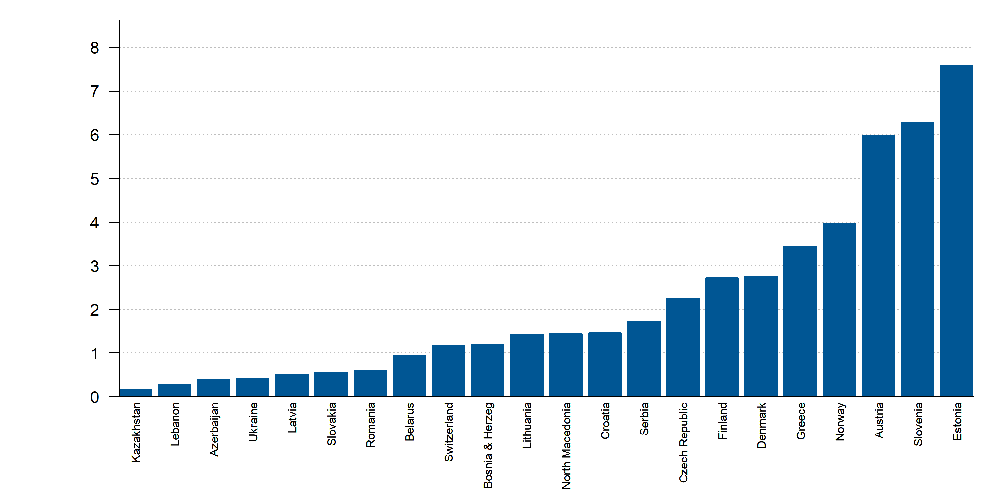
Cardiology departments performing device-based decongestion therapy (per million people), 2018 or latest year
Source: HFA Survey. Missing: Belgium, Bulgaria, Cyprus, Georgia, Germany, Hungary, Iceland, Ireland, Italy, Netherlands, Poland, Portugal, Russia, Spain, Sweden, Turkey, United Kingdom. Resource not available: Israel, Kyrgyzstan, Moldova.

Slide 53
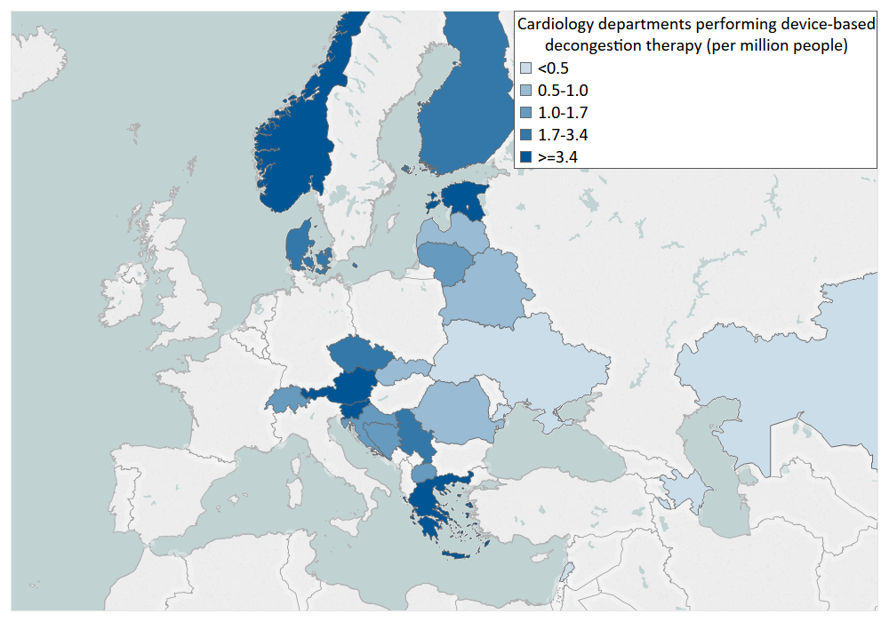
Cardiology departments performing device-based decongestion therapy (per million people), 2018 or latest year
Source: HFA Survey. Missing: Belgium, Bulgaria, Cyprus, Georgia, Germany, Hungary, Iceland, Ireland, Italy, Netherlands, Poland, Portugal, Russia, Spain, Sweden, Turkey, United Kingdom. Resource not available: Israel, Kyrgyzstan, Moldova.

Slide 54
Services and Interventions

Slide 55
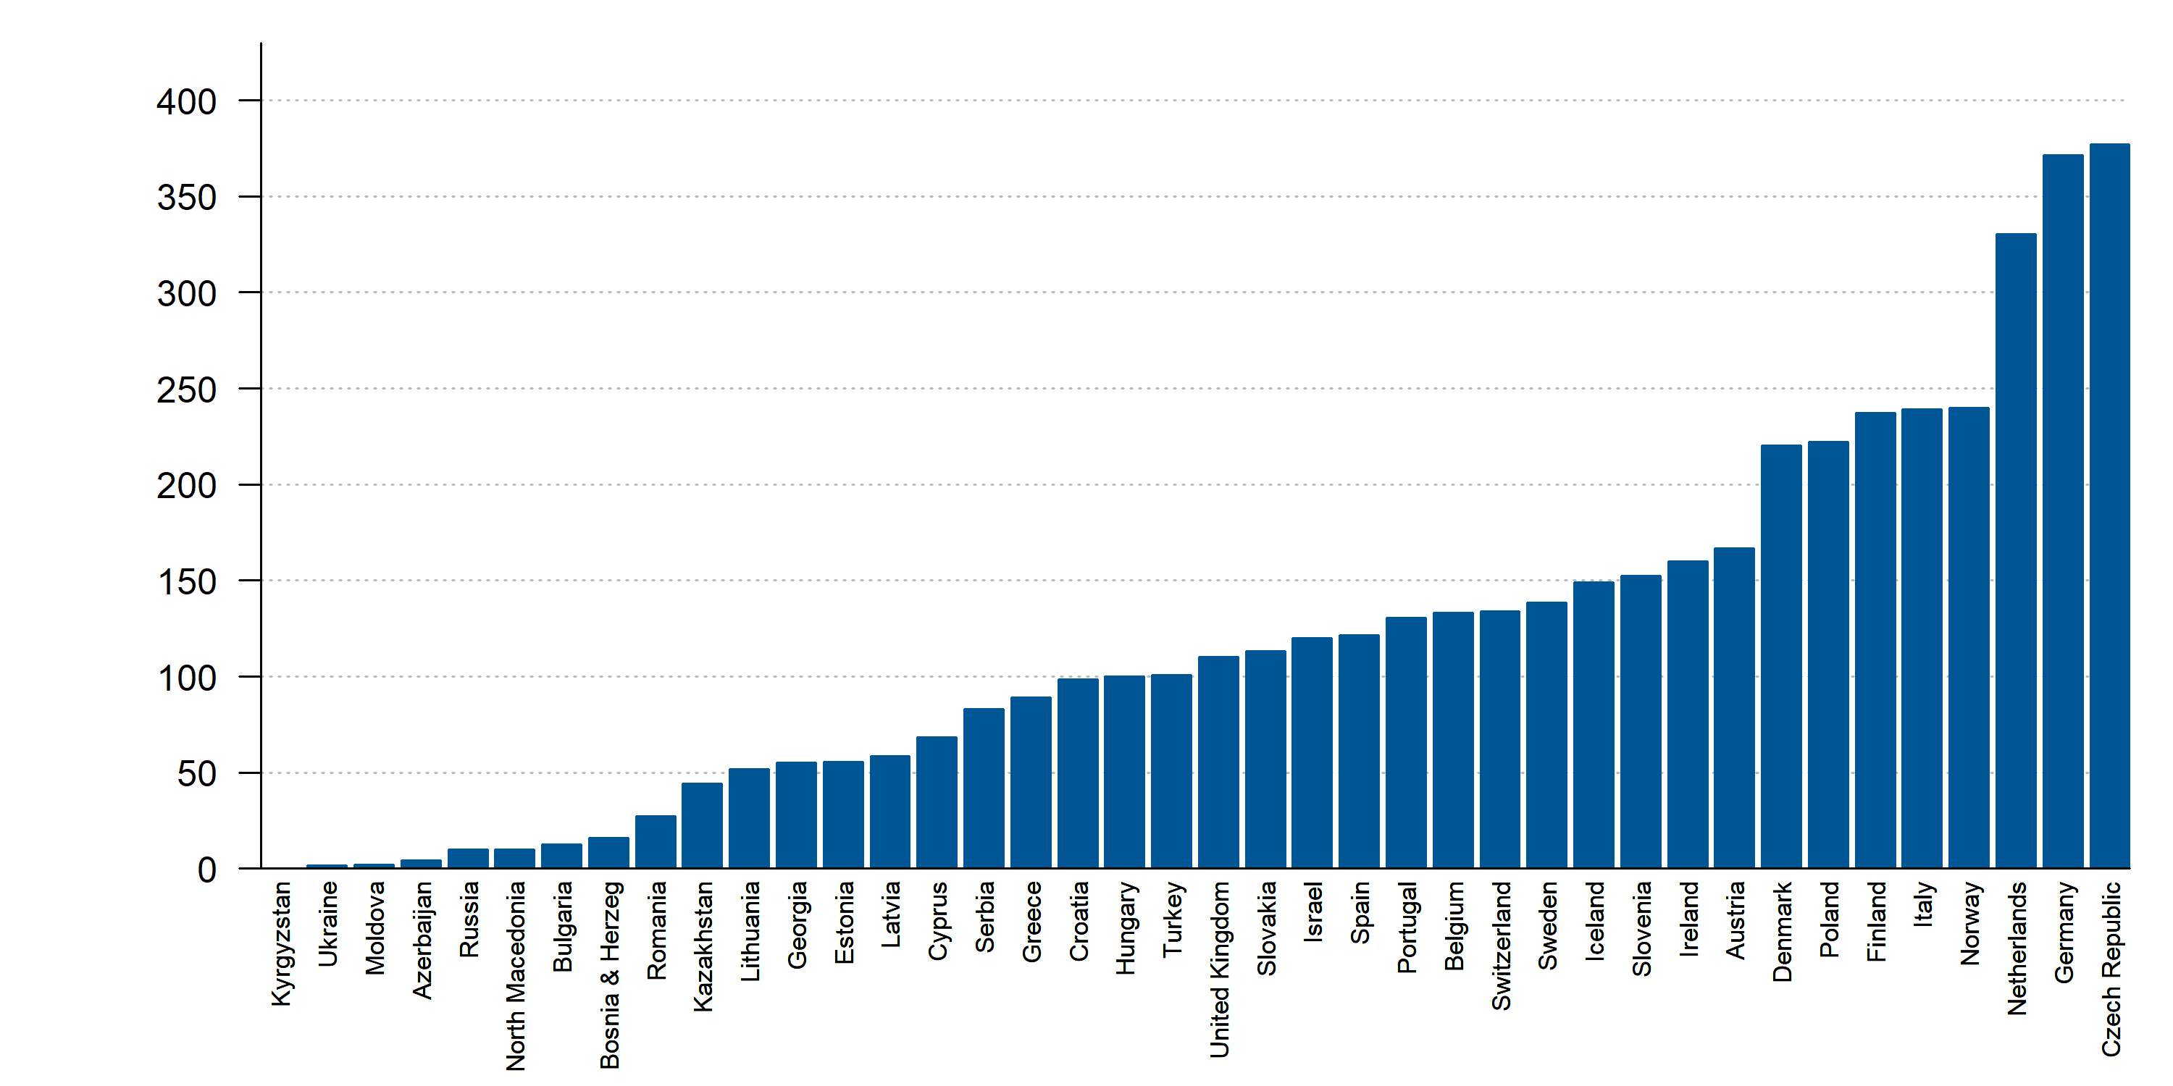
Implantable cardioverter defibrillator (ICD) implantations (per million people), 2017 or latest year
Source: EHRA White Book, ESC Survey. Missing: Belarus, Lebanon.

Slide 56
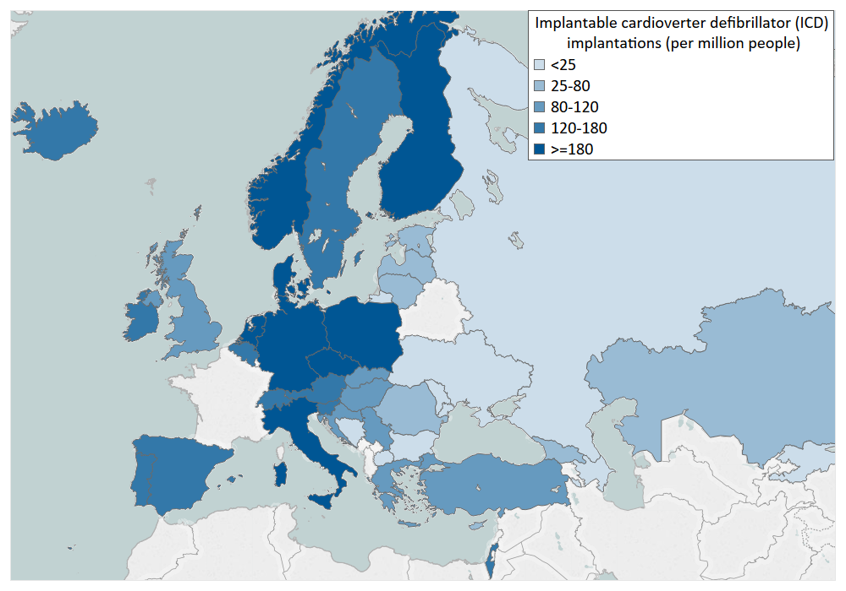
Implantable cardioverter defibrillator (ICD) implantations (per million people), 2017 or latest year
Source: EHRA White Book, ESC Survey. Missing: Belarus, Lebanon.

Slide 57
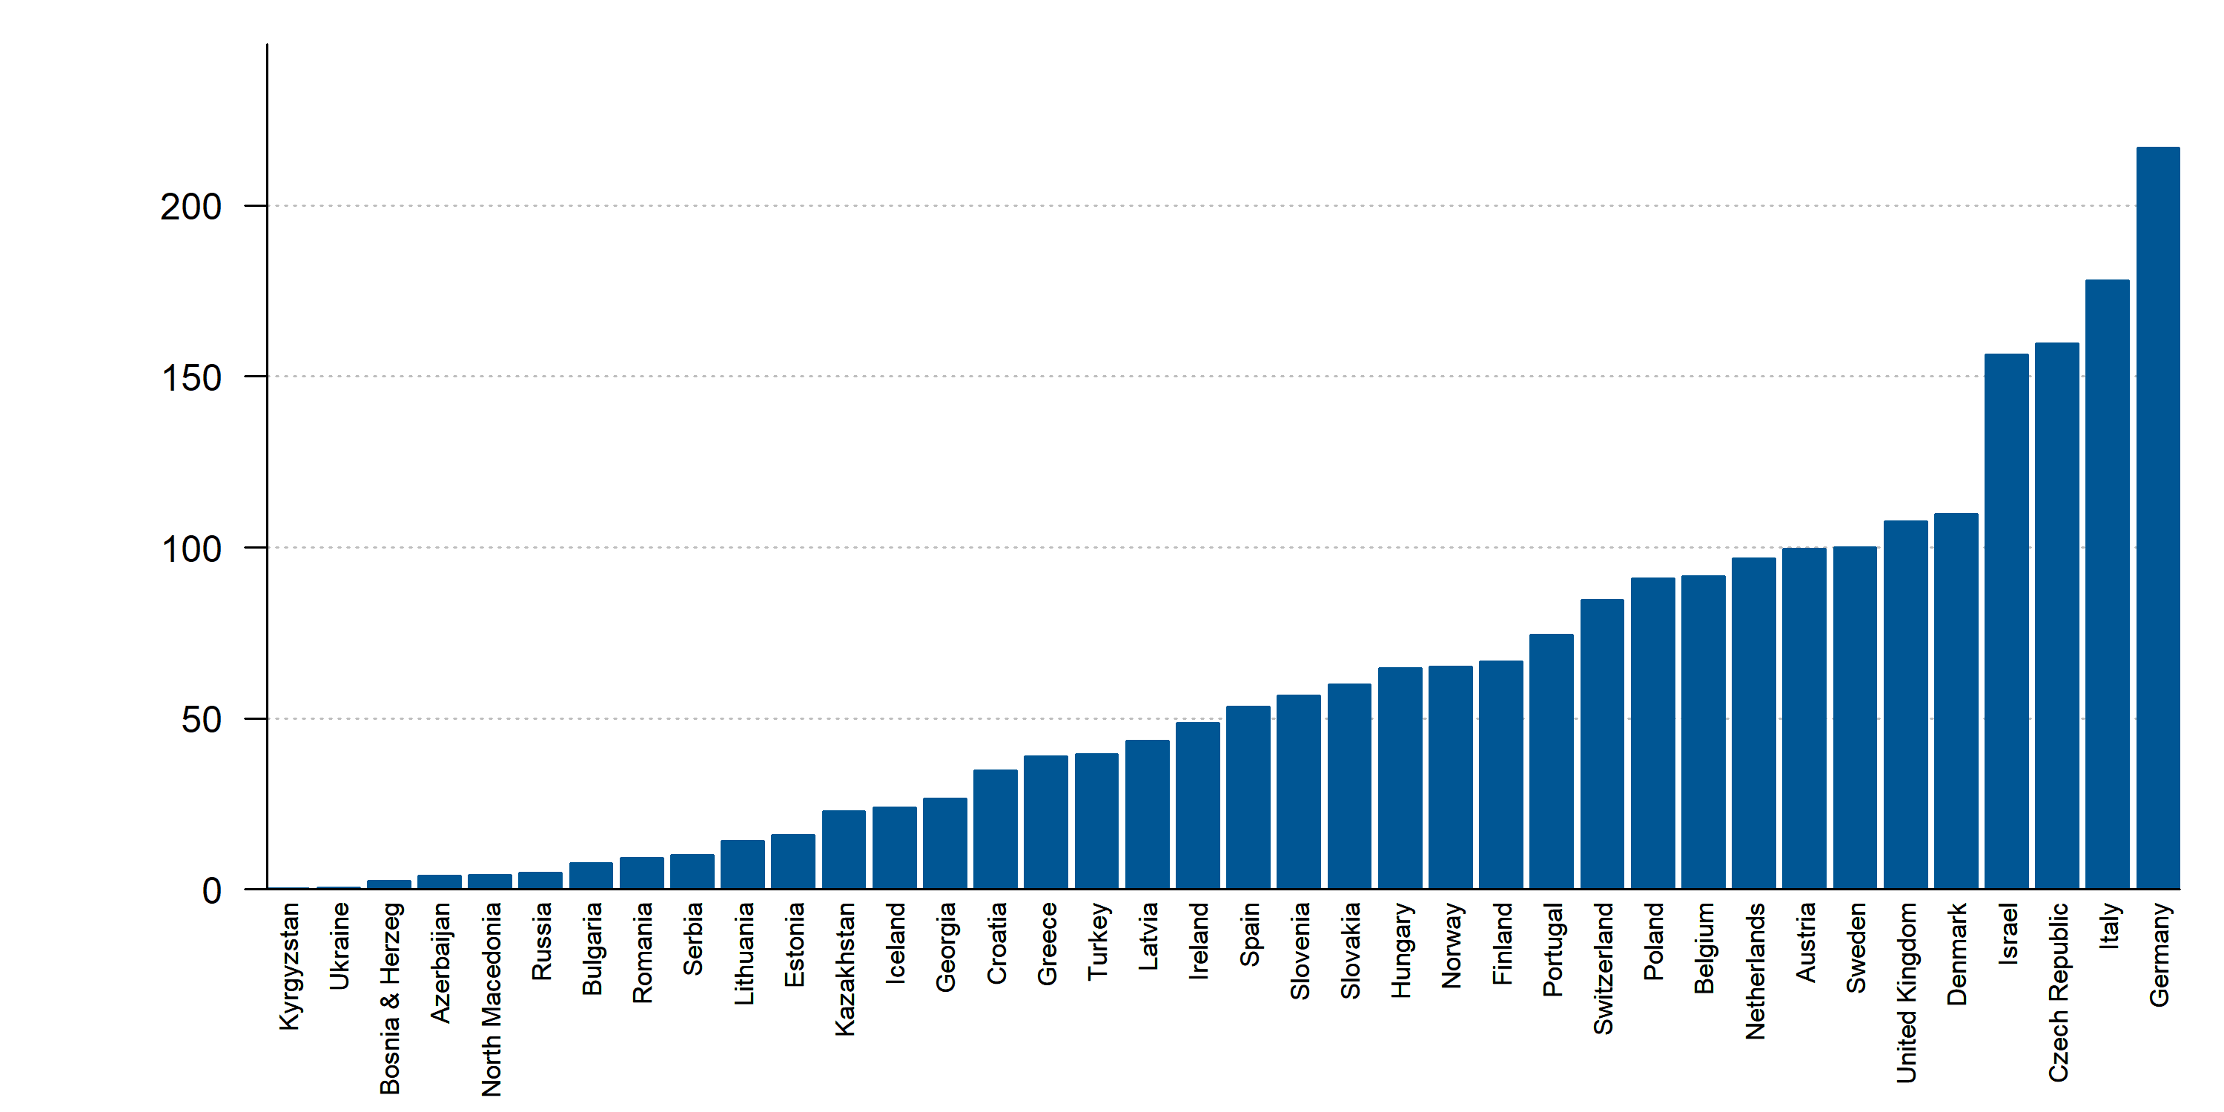
Cardiac resynchronization therapy ICD (CRT-D) implantations (per million people), 2017 or latest year
Source: EHRA White Book, ESC Survey. Missing: Belarus, Cyprus, Lebanon. Resource not available: Moldova.

Slide 58
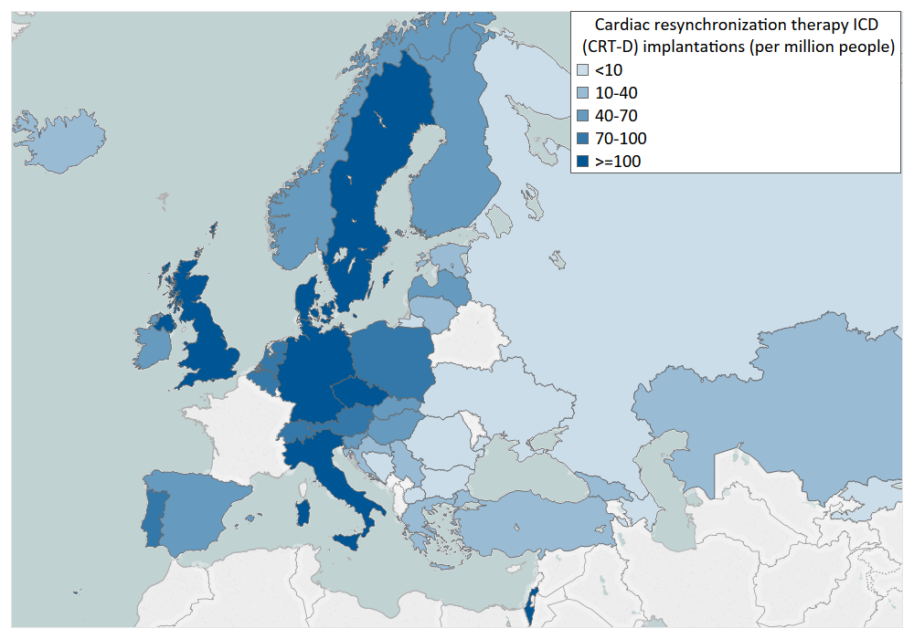
Cardiac resynchronization therapy ICD (CRT-D) implantations (per million people), 2017 or latest year
Source: EHRA White Book, ESC Survey. Missing: Belarus, Cyprus, Lebanon. Resource not available: Moldova.

Slide 59
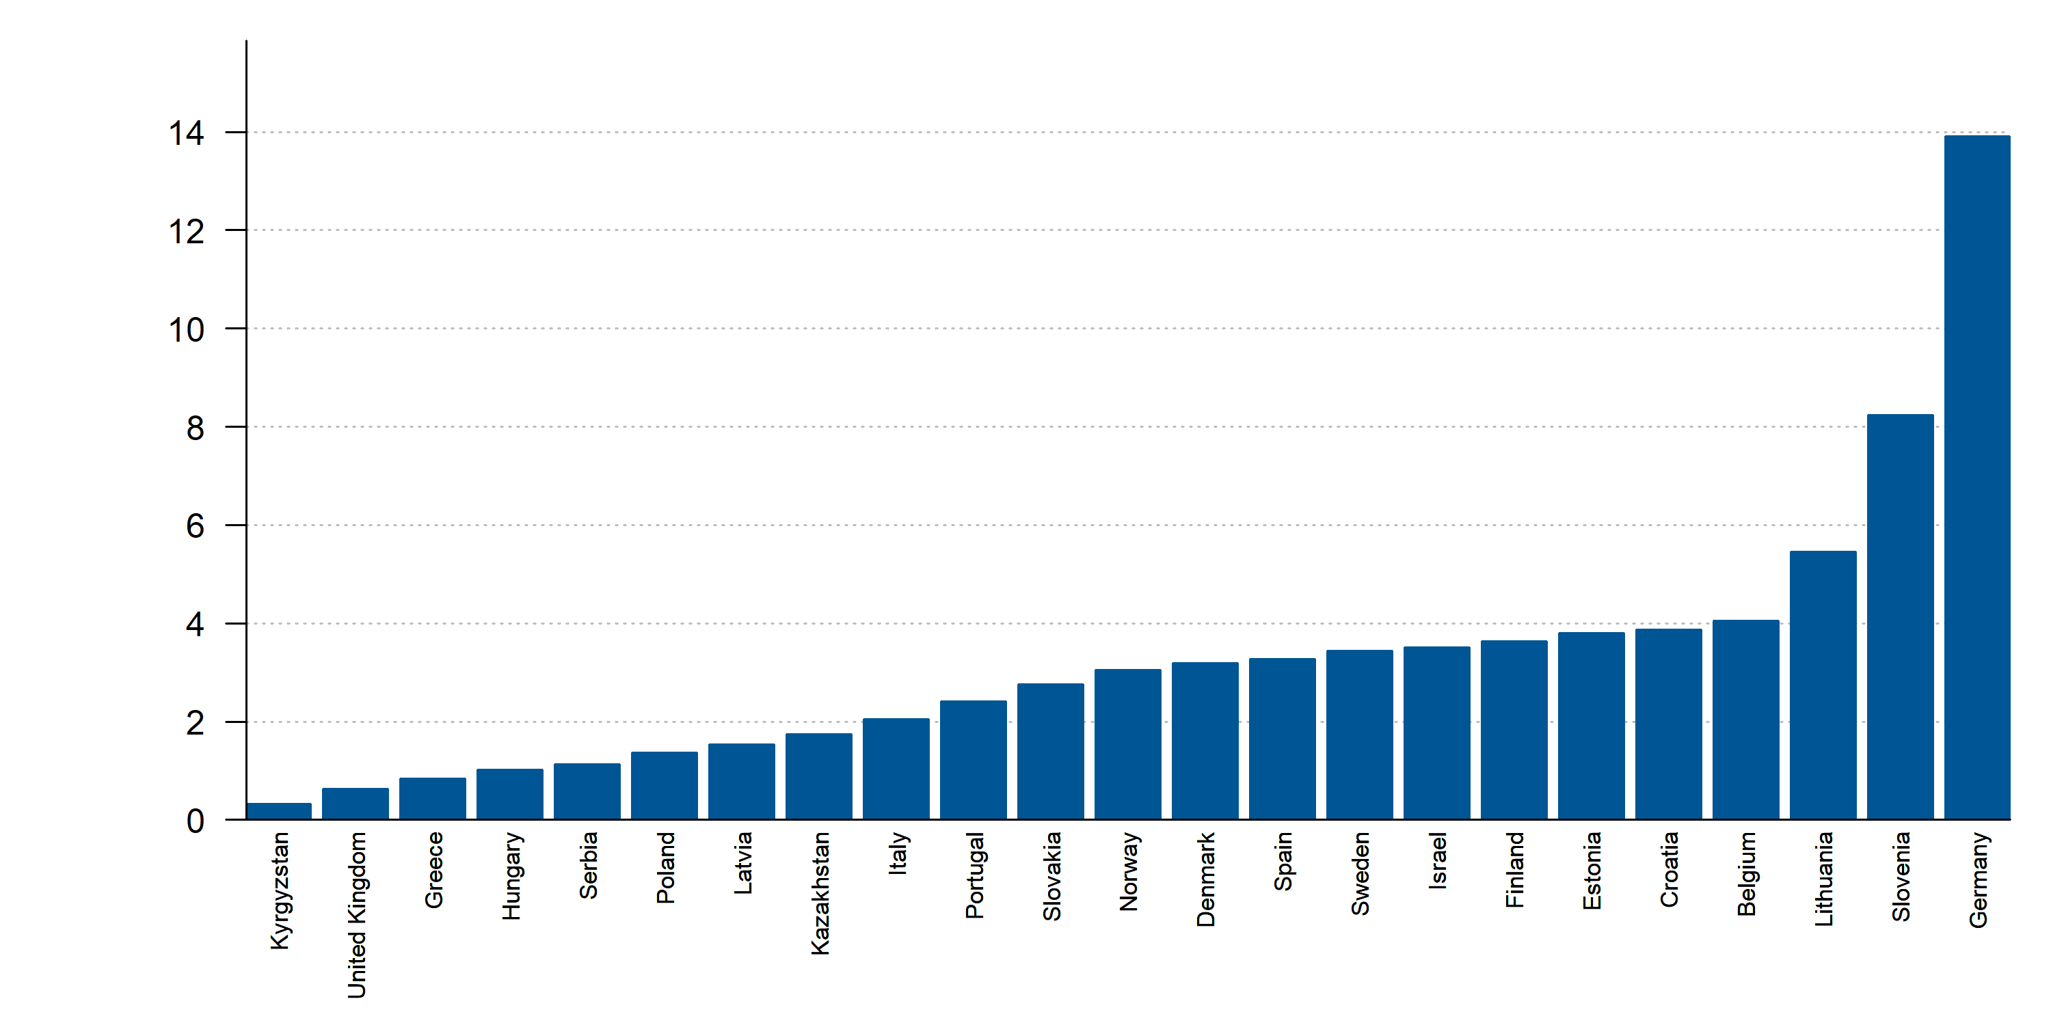
Left ventricular assist device (LVAD) implantations (per million people), 2017 or latest year
Source: ESC Survey. Missing: Austria, Belarus, Bulgaria, Czech Republic, Ireland, Lebanon, Netherlands, Romania, Russia, Switzerland, Turkey, Ukraine. Resource not available: Azerbaijan, Bosnia and Herzegovina, Cyprus, Georgia, Iceland, North Macedonia, Moldova.

Slide 60
Left ventricular assist device (LVAD) implantations (per million people), 2017 or latest year
Source: ESC Survey. Missing: Austria, Belarus, Bulgaria, Czech Republic, Ireland, Lebanon, Netherlands, Romania, Russia, Switzerland, Turkey, Ukraine. Resource not available: Azerbaijan, Bosnia and Herzegovina, Cyprus, Georgia, Iceland, North Macedonia, Moldova.

Slide 61
Heart transplantations (per million people), 2017 or latest year
Source: ESC Survey, Ministry of Health. Missing: Belarus, Lebanon, Russia. Resource not available: Azerbaijan, Bosnia and Herzegovina, Cyprus, Estonia, Georgia, Iceland, Kyrgyzstan, North Macedonia, Moldova, Ukraine.

Slide 62
Heart transplantations (per million people), 2017 or latest year
Source: ESC Survey, Ministry of Health. Missing: Belarus, Lebanon, Russia. Resource not available: Azerbaijan, Bosnia and Herzegovina, Cyprus, Estonia, Georgia, Iceland, Kyrgyzstan, North Macedonia, Moldova, Ukraine.

Slide 63
Definitions

Slide 64
Definitions
•Population ages 65 and above (% of total population): Population ages 65 and above as a
percentage of the total population. Population is based on the de facto definition of population,
which counts all residents regardless of legal status or citizenship. World Bank staff estimates using
the World Bank's total population and age/sex distributions of the United Nations Population
Division's World Population Prospects: 2017 Revision
•Life expectancy at birth, female (years): The average number of years that a female newborncould
expect to live, if she were to pass through life exposed to the sex and age-specific death rates
prevailing at the time of her birth, for a specific year, in a given country, territory or geographic area.
•Life expectancy at birth, male (years): The average number of years that a male newborncould
expect to live, if he were to pass through life exposed to the sex and age-specific death rates
prevailing at the time of his birth, for a specific year, in a given country, territory or geographic area.

Slide 65
Definitions
•Physicians(permillionpeople):Totalnumberofmedicaldoctors(physicians)inthecountry,
expressedascruderatepermillionpeople.
•Cardiologists(permillionpeople):Thetotalnumberofcardiologistspractisinginthecountry,
expressedascruderatepermillionpeople.
•Hospitals(permillionpeople):Numberofhospitalsinthecountry,expressedascruderateper
millionpeople.Hospitalscompriselicensedestablishmentsprimarilyengagedinprovidingmedical,
diagnostic,andtreatmentservicesthatincludephysician,nursing,andotherhealthservicestoin-
patientsandthespecialisedaccommodationservicesrequiredbyin-patients.Hospitalsmayalso
provideout-patientservicesasasecondaryactivity.Hospitalsprovidein-patienthealthservices,
manyofwhichcanonlybeprovidedusingthespecialisedfacilitiesandequipmentthatforma
significantandintegralpartoftheproductionprocess.Insomecountries,healthfacilitiesneedin
additionaminimumsize(suchasnumberofbeds)inordertoberegisteredasahospital.

Slide 66
Definitions
• IncidenceofHF(per1000person-years):TotalnumberofnewdiagnosisofHFper1000person
yearsinthetotalpopulationofthecountry.
•PrevalenceofHF(per1000persons):Totalnumberofpatientsper1000personswithadocumented
diagnosisofHFinthetotalpopulationofthecountry
•NumberofHF-relatedhospitaldischarges (per million people):NumberofHF-relatedhospitaldischarges
(per million people).A hospitaldischargeistheformalreleaseofapatientfromahospital.Itincludes
discharges fromallhospitals,includinggeneralhospitals,andotherspecializedhospitalswithaprimary
diagnosisofHF.
•Average length of stay in hospital primarily due to HF: Average length of stay is calculated by dividing
the number of bed-days due to HF by the number of discharges during the year in any hospital or
health system.

Slide 67
Definitions
•Hospitals with dedicated HF centers(per million people): The number of hospitals with specific rooms
and a team of health professionals dedicated (full or part time) to the diagnosis and treatment of
patients with HF; expressed as crude rate per million people
•Hospitals with availability to obtain BNP (NT-proBNP) in ER (per million people) : The number of
hospitals with the capacity to have the measurement of BNP or NT-proBNPavailable for patients
admitted to the Emergency Room; expressed as crude rate per million people.
•Cardiac MRI units (per million people): The number of magnetic resonance units (MRI) with the
possibility to perform cardiac examinations, established in public and private sector; expressed as
•Hospitalsperformingspiro-ergometry(permillionpeople):Thenumberofhospitalswiththe
capacitytoperformspiro-ergometryforHFpatients,expressedascruderatepermillionpeople.

Slide 68
Definitions
•HospitalsperformingHFexerciseprogramsforHFpatients(permillionpeople):Thenumberof
hospitalswiththecapacitytoperformHFexerciseprogramsforHFpatients,expressedascruderate
permillionpeople.
•Hospitals implanting implantable cardioverter defibrillators (ICD) (per million people): The total
number of hospitals, public or private, implanting implantable cardioverter defibrillators (ICDs),
expressed as crude rate per million people. If a hospital has more than one lab implanting
pacemakers, it is counted as one.
•Hospitalsimplantingcardiacresynchronizationtherapy(CRT)devices(permillionpeople):Thetotal
numberofhospitals,publicorprivate,implantingcardiacresynchronizationtherapy(CRT),implantable
withorwithoutICD,expressedascruderatepermillionpeople.
•Hospitalswithcathlabs(permillionpeople):Thetotalnumberofhospitals,publicorprivate,withone
ormorecathlabsperformingeitherdiagnosticcoronaryangiographiesorpercutaneouscoronary
interventions(PCI),irrespectiveofwhethertheprocedureoccursonanambulatorybasisorwith
overnightstay;expressedascruderatepermillionpeople.Ifahospitalhasmorethanonecathlab,itis
countedasone.

Slide 69
Definitions
•Hospitalswithcardiacsurgery(permillionpeople):Thetotalnumberofhospitals,publicorprivate,
inwhichcardiacsurgeriesareundertakenonsitetotreatsurgicallycardiovasculardiseases,expressed
ascruderatepermillionpeople.
•HospitalsimplantingMitraclip(permillionpeople):ThenumberofhospitalsimplantingMitraclip,
expressedascruderatepermillionpeople.
•Hospitalsimplantingleftventricularassistdevices(LVAD)(permillionpeople):Thenumberof
hospitalsimplantingleftventricularassistdevices(LVAD),expressedascruderatepermillionpeople.
•Hospitalswithcardiac transplantation program (permillionpeople):Thetotalnumberofhospitals,public
orprivate, undertaking cardiac transplantations expressed ascruderatepermillionpeople.
•Cardiologydepartmentsperformingdevice-baseddecongestiontherapy(permillionpeople):The
numberofcardiologydepartmentswiththecapacitytoperformdevice-baseddecongestiontherapy
(e.g.ultrafiltration),expressedascruderatepermillionpeople.

Slide 70
Definitions
•Implantablecardioverterdefibrillator(ICD)implantations(permillionpeople):Thetotalannual
numberofimplantablecardioverterdefibrillator(ICD)implantations,expressedascruderateper
millionpeople.ItexcludescardiacresynchronizationtherapyICDdevices(CRT-D)implantations.It
includesfirstimplantationaswellasreplacements.
•CardiacresynchronizationtherapyICD(CRT-D)implantations(permillionpeople):Thetotalannual
numberofcardiacresynchronizationcardioverterdefibrillatordevice(CRT-D)implantationsundertaken,
expressedascruderatepermillionpeople.Itincludesfirstimplantationaswellasreplacements.
•Leftventricularassistdevice(LVAD)implantations(permillionpeople):Thetotalannualnumberofleft
ventricularassistdevices(LVAD)implantations(IABPandIMPELLA-likedevicesexcluded)expressedas
cruderatepermillionpeople.
•Hearttransplantations(permillionpeople):Thetotalannualnumberofhearttransplantations
undertakeninthecountry,expressedascruderatepermillionpeople.

Slide 71
Disclaimer

Slide 72
Disclaimer
•Despitebesteffortstoattainqualitativeandcompletedataanddespitethemethodologicalsteps
outlinedintheintroduction,itmustbeacknowledgedthat,asisalwaysthecasewithinitiativesofthis
kind,dataqualityandcredibilityissuesalwaysexist,especiallygiventhatthisisthefirsttimethatthis
projectisundertaken.Overtheyearsthisexercisewillimproveandinconsequencealsothedataquality
andcredibility.
•Regardless,alwaysdatacomingfromavarietyofsourcesacrossdifferentcountriesshouldbeviewed
withcaution.Also,differencesbetweencardiacproceduresmaybecausedbythefactthatthereare
alternativeswhichmaybeuseddifferentlyindifferentcountries.
•Therefore,itneedstobepointedoutthat,whileindicatorsarepresentedandassociatedwitheach
otherforcomparativepurposes,itneedstobevividlynotedthathealthcarerealityisverycomplexand
simplecomparisonsshouldbeviewedwithcautionandthereareseriousrisksofmisinterpretationifone
neglectsthesimultaneousimpactsofmanydifferentconfoundingfactorswhichmaydeterminethe
variablesofinterest.

Slide 73
Legalmentions

Slide 74
Legal mentions
TheEuropeanSocietyofCardiology(ESC)doesitsutmosttoprovideuserswithavailableandverified
informationandtoolsandshallnotbeliableforanyerrors,absence,unavailabilityofdataof
authorisation.
ESCshallnotbeliableforanyunauthoriseduseofdatacollectedfromexternalsourcesbyESCmembers.
DataprovidedbyESCisforinformationpurposesonly.ESCcannotguaranteethecorrectness,accuracy,
completenessandcurrencyofdatapublishedonthewebsite,noritsappropriatenesstoanyuser's
requirements.
Usersherebyconfirmtheyaresolelyliablefortheusemadeofthedataavailableinthisreport.
Usersundertakenottousethesiteservicesoranyinformationtowhichtheymighthaveaccessfor
purposesthatmightconflictwithpublicpolicyorcommondecencyorinfringethirdpartyrights.

Slide 75
Abbreviations

Slide 76
Abbreviations
CRT-P Cardiacresynchronizationtherapypacemaker
ESC EuropeanSocietyofCardiology
HF HeartFailure
HFA HeartFailureAssociation
ICD ImplantableCardioverterDefibrillator
LVAD LeftVentricularAssistDevices
MRI MagneticResonanceImaging
NT-proBNPN-Terminalpro-BrainNatriureticPeptide

